Slide 1
Gamma = 0.9
Epsilon_updater = 0.99

Slide 2
Reward shaping
How to avoid lazy agents?
Each one gets a -1
Encourage agents to be close to other types of agents
Note: the more agents, the more immediate rewards, and learns better

Slide 3
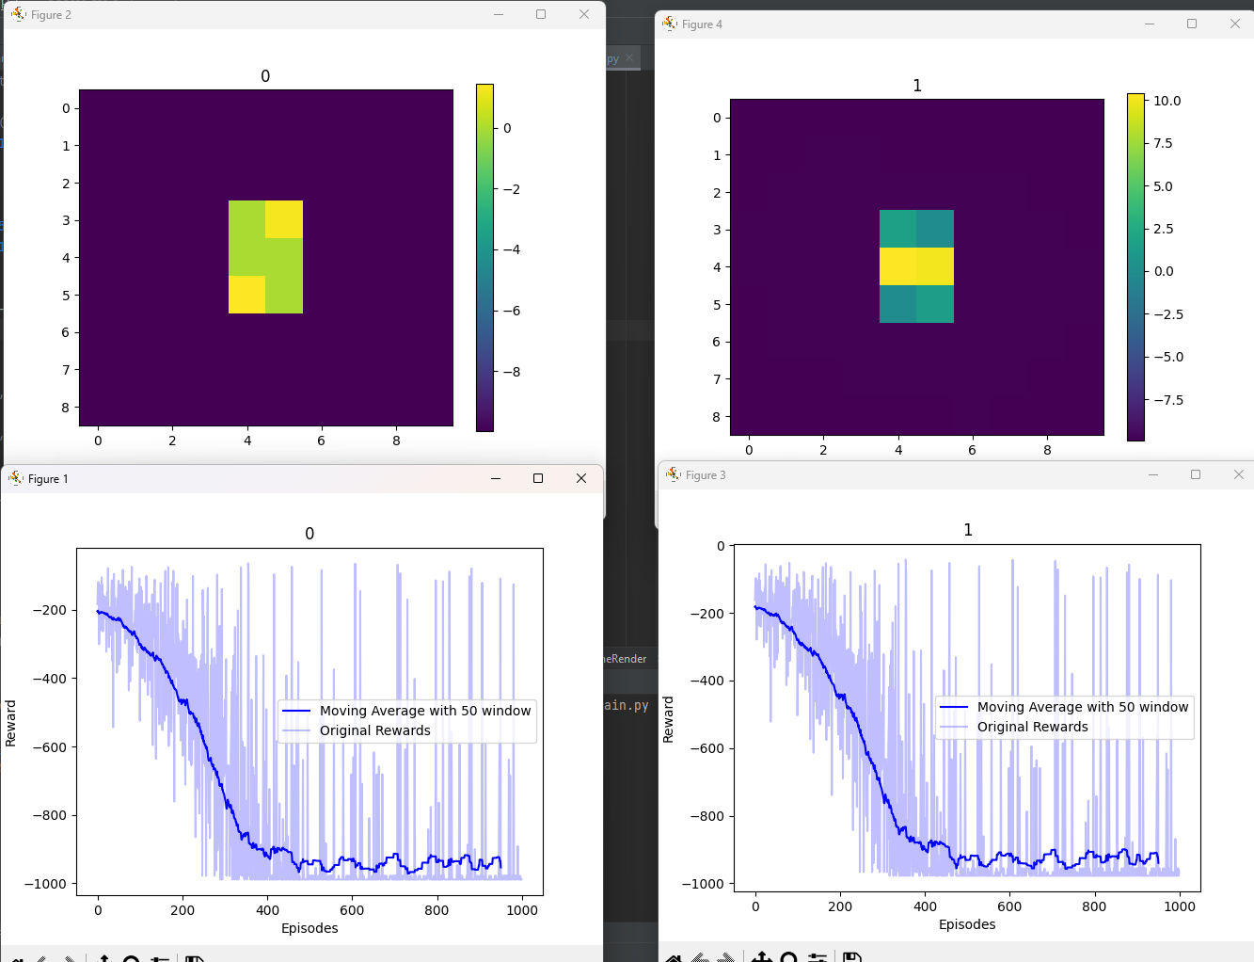

Slide 4
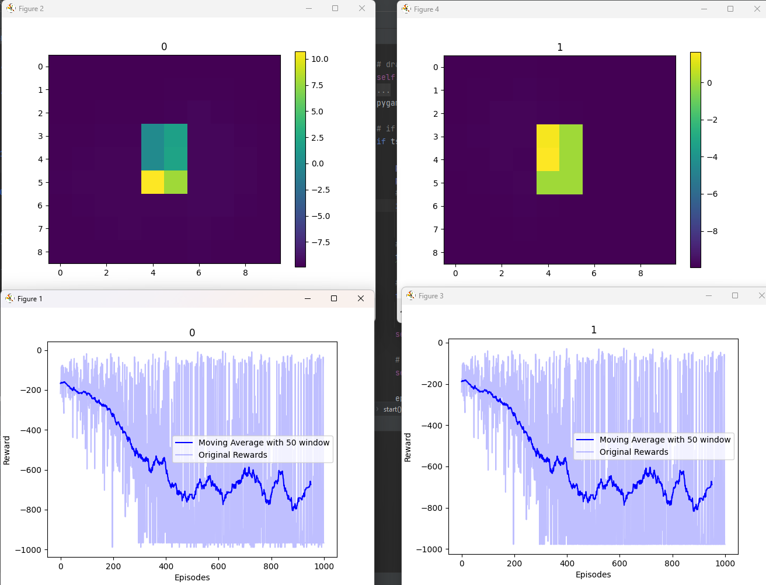

Slide 6
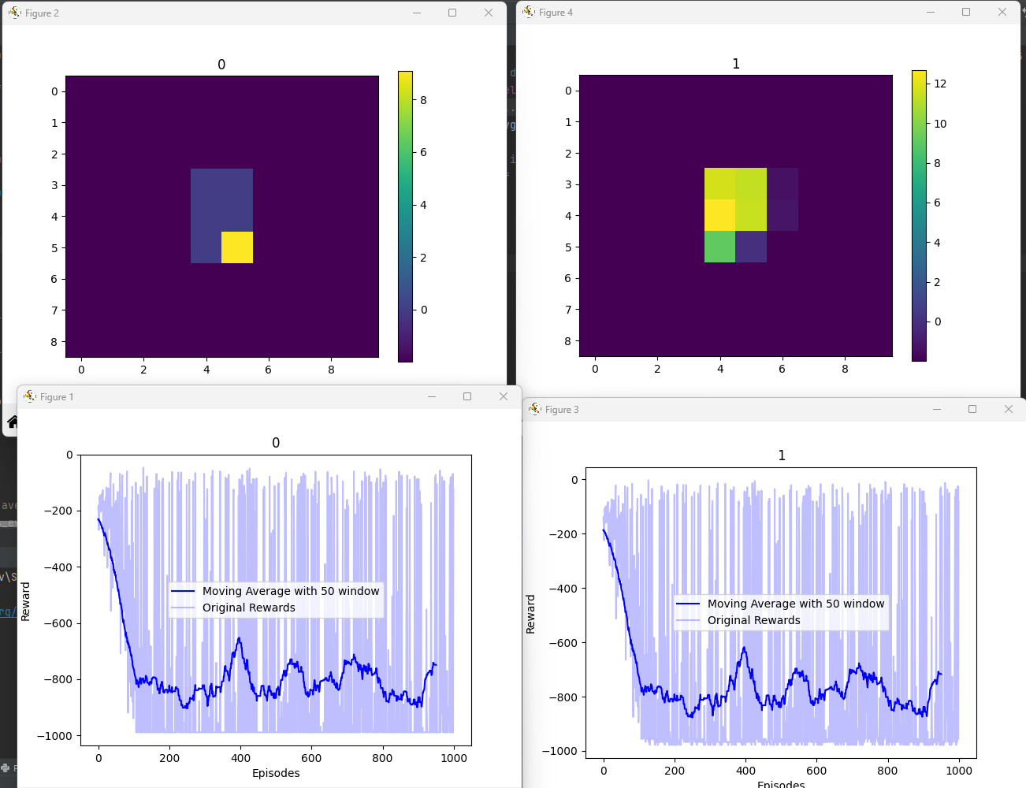
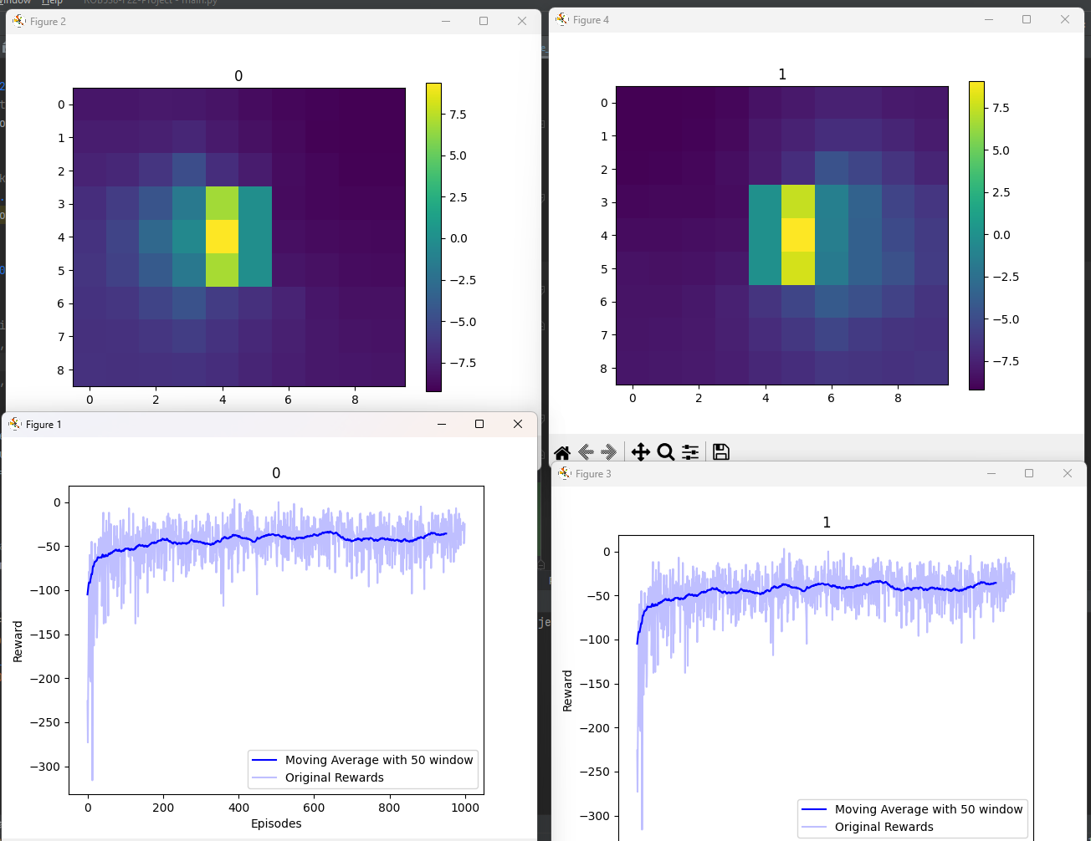
Gamma = 0.5
Epsilon*0.9
Gamma = 0.9
Epsilon * 0.99

Slide 7
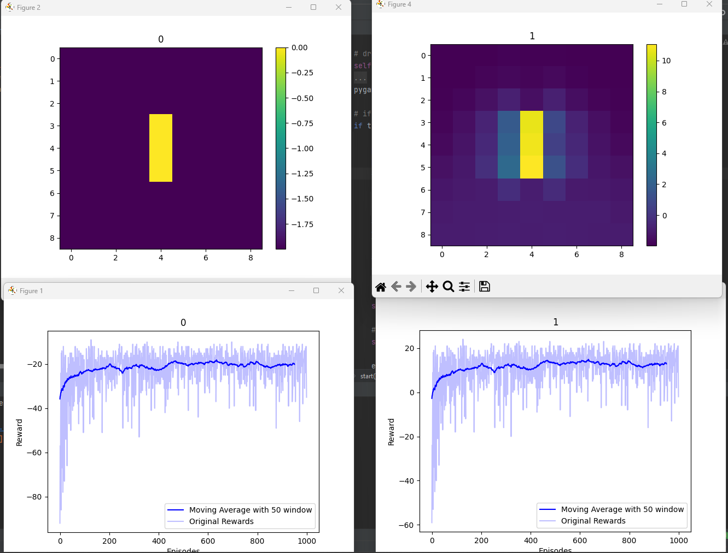
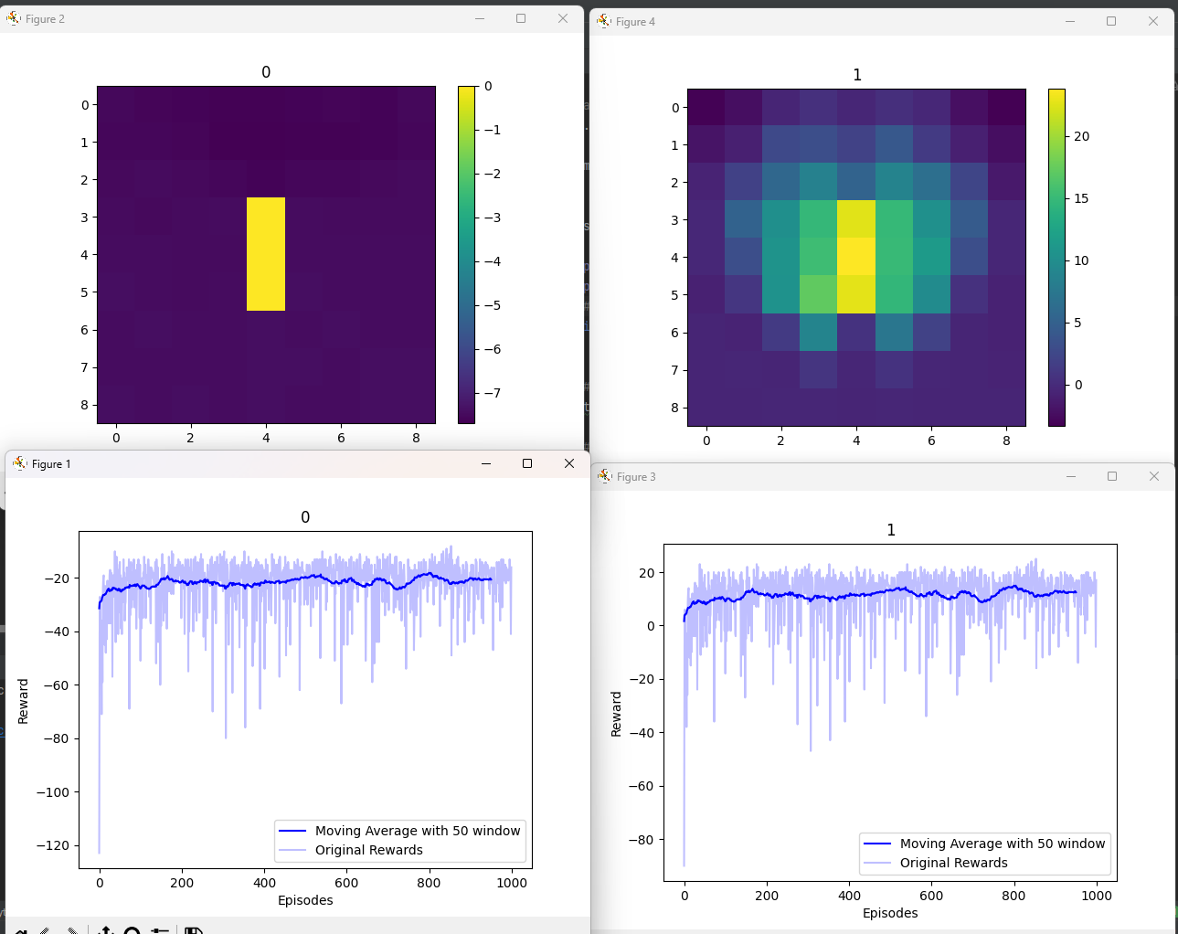
Gamma = 0.5
Gamma = 0.9

Slide 8
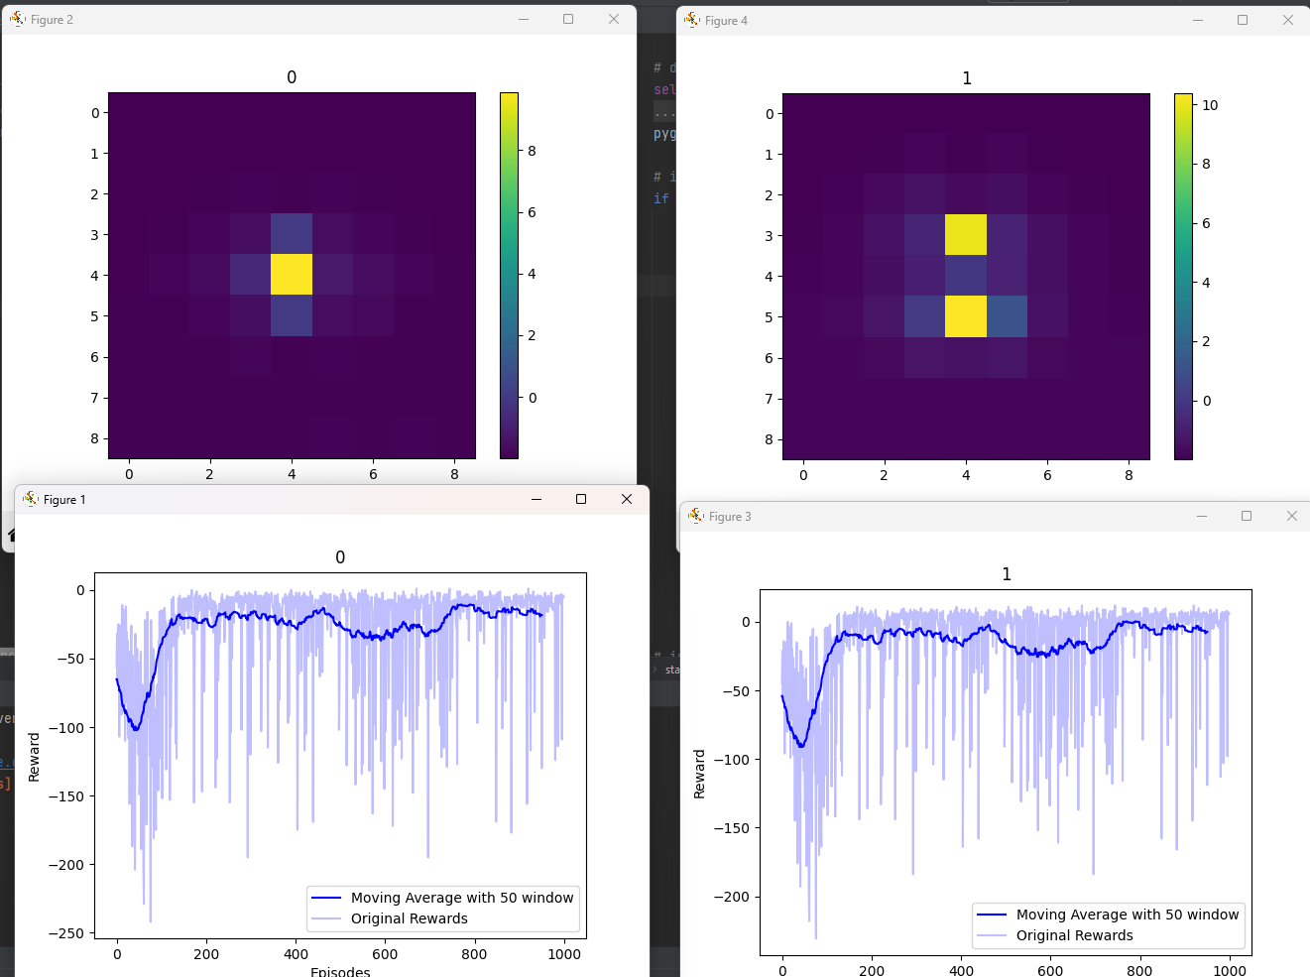
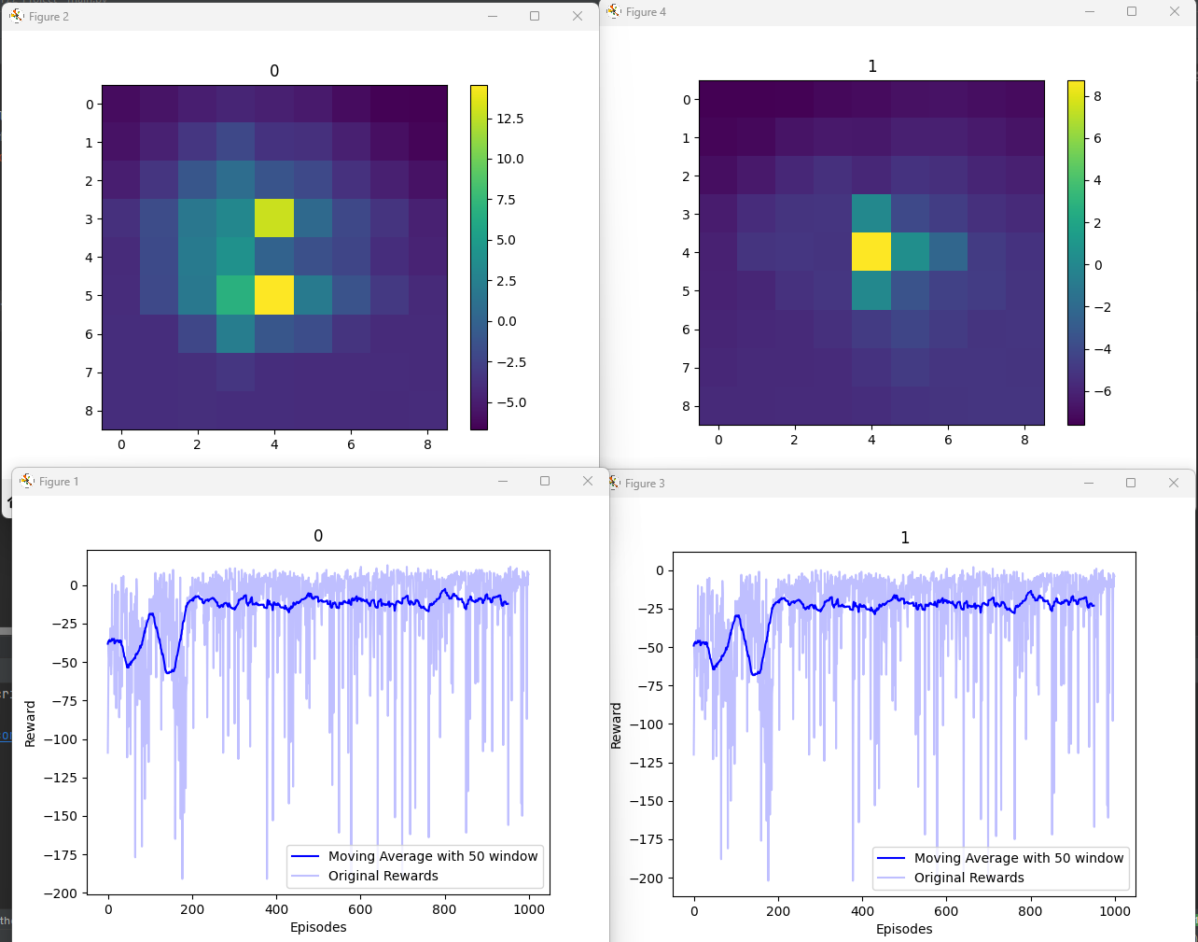
Gamma = 0.5
Gamma = 0.9

Slide 9
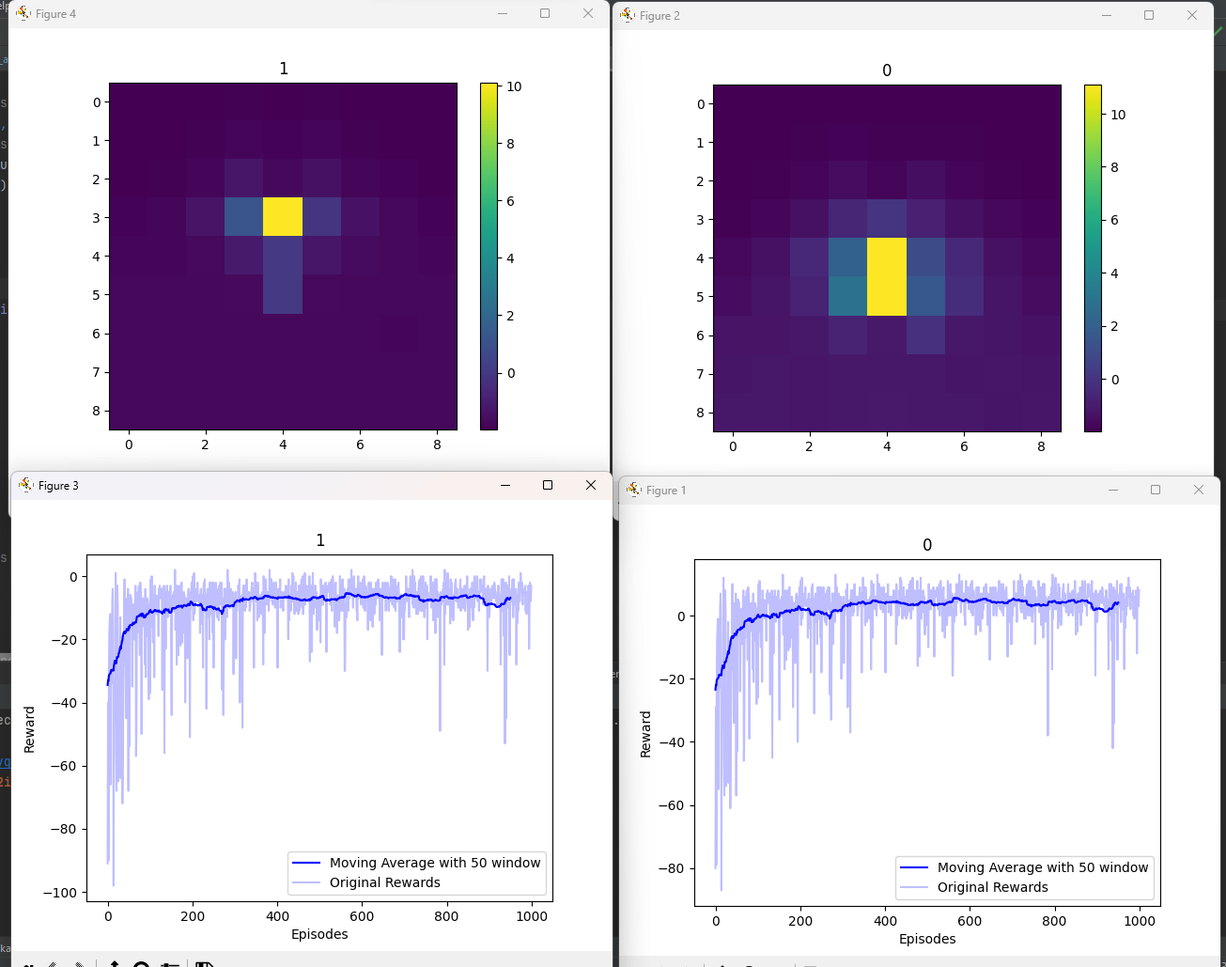
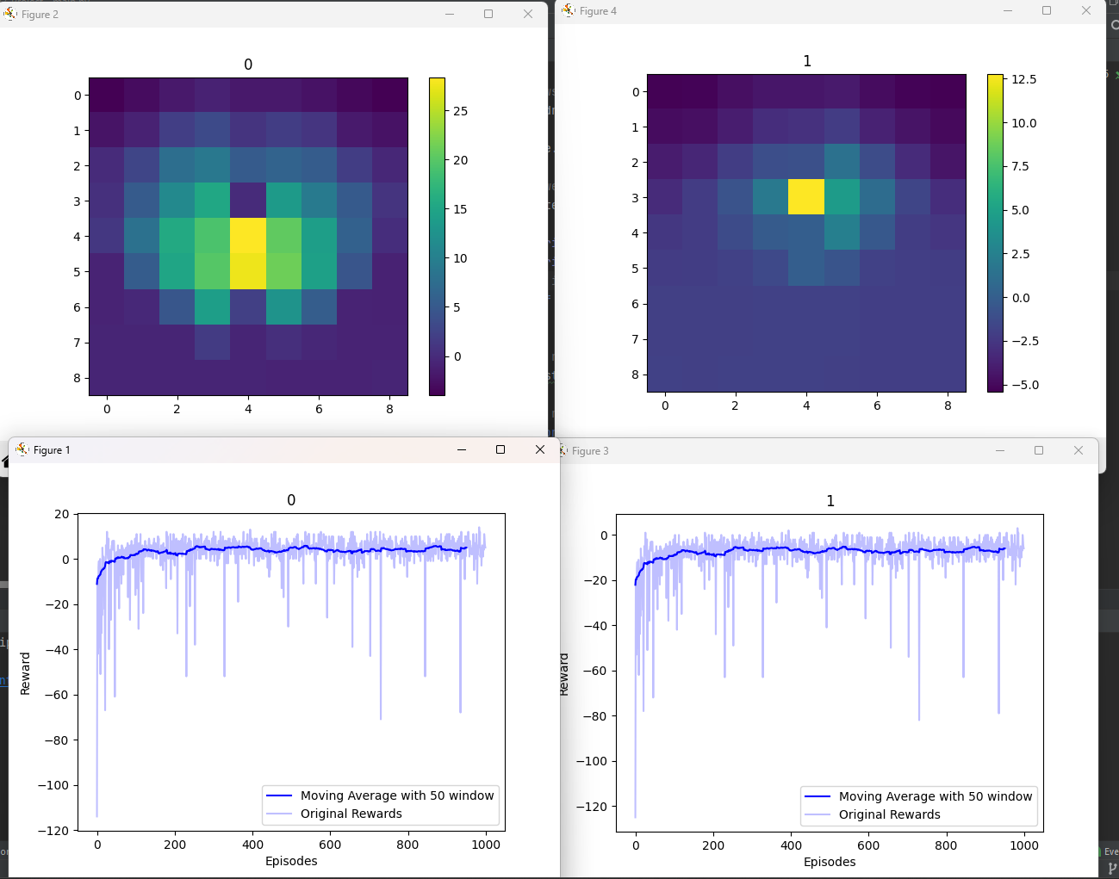
Gamma = 0.5
Gamma = 0.9

Slide 10
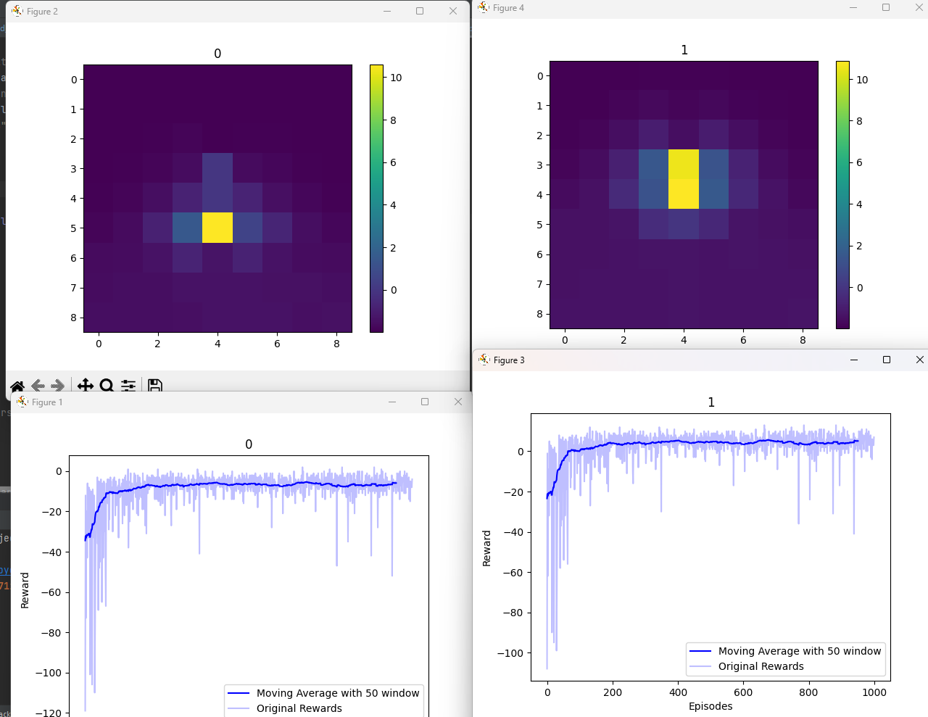
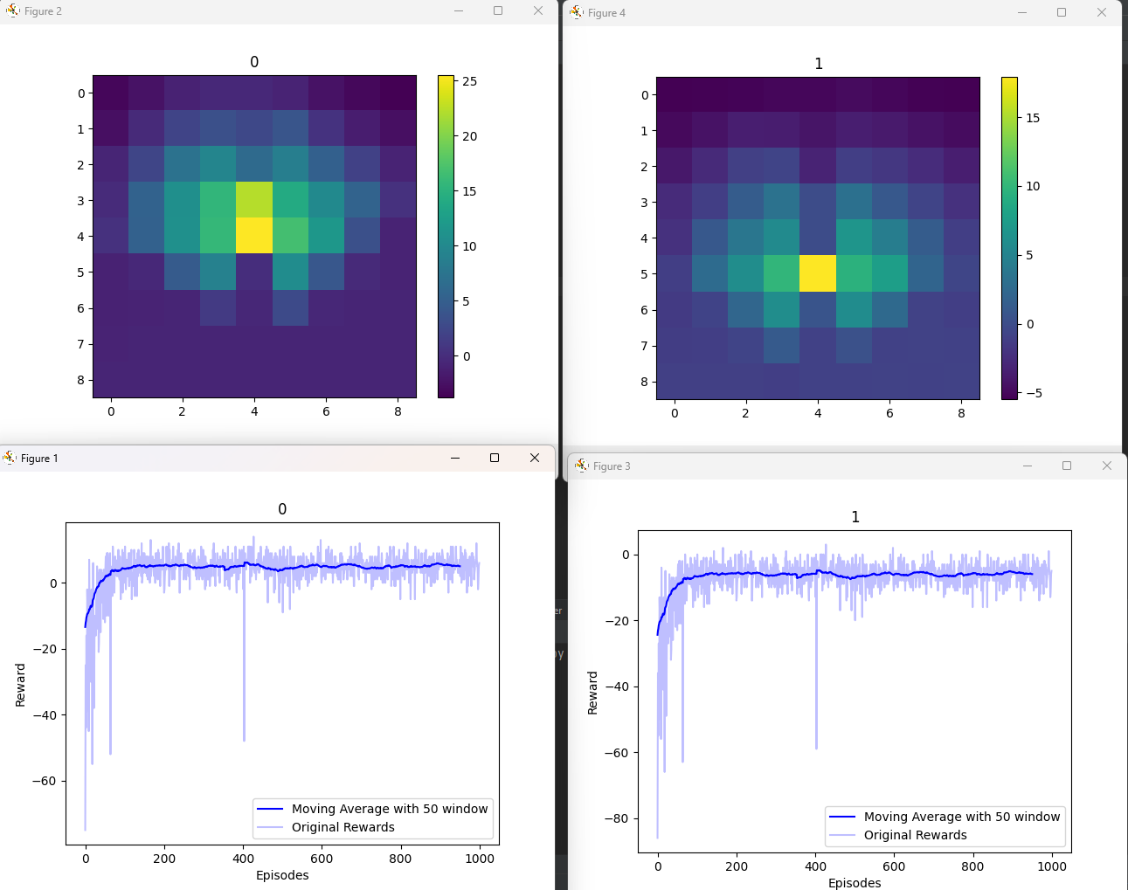
Gamma = 0.5
Gamma = 0.9

Slide 11
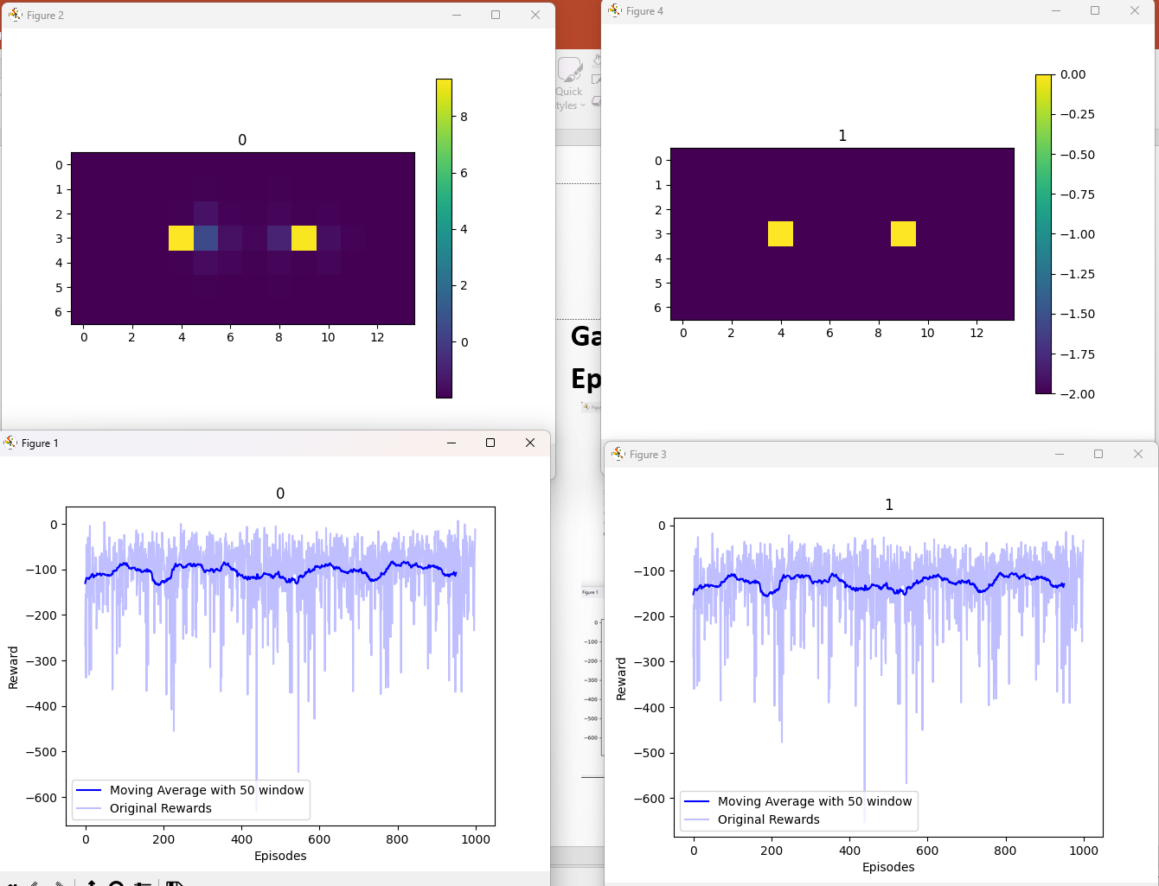
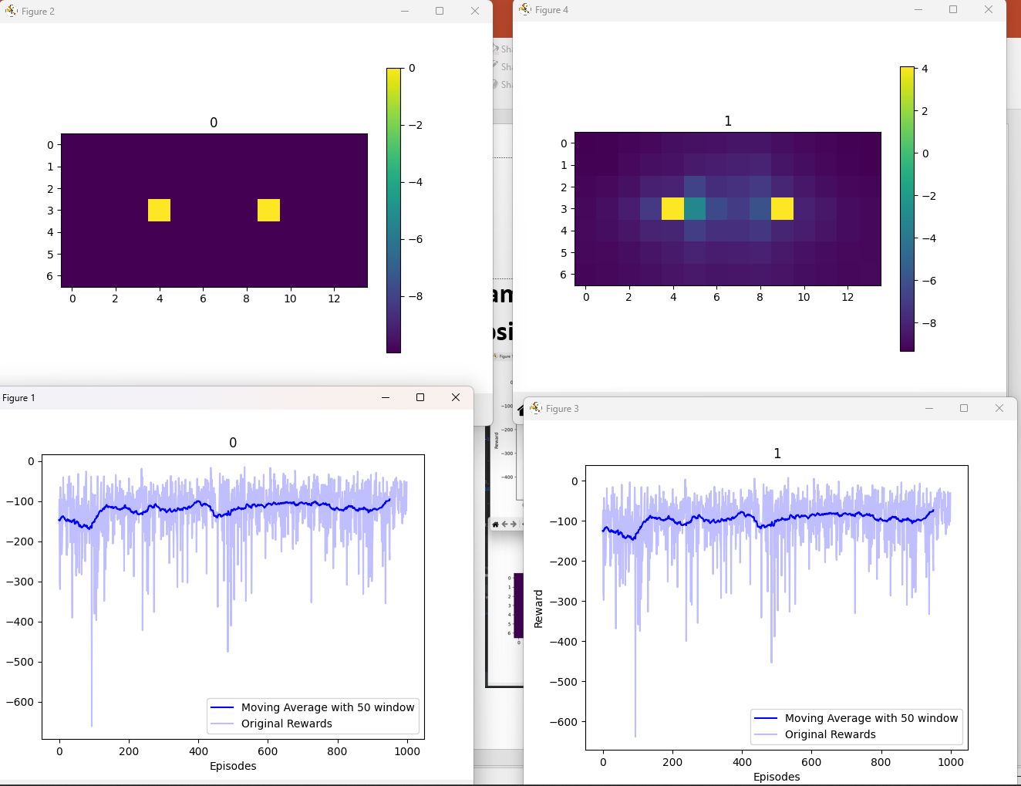
Gamma = 0.5
Epsilon * 0.995
Gamma = 0.9
Epsilon * 0.995

Slide 12
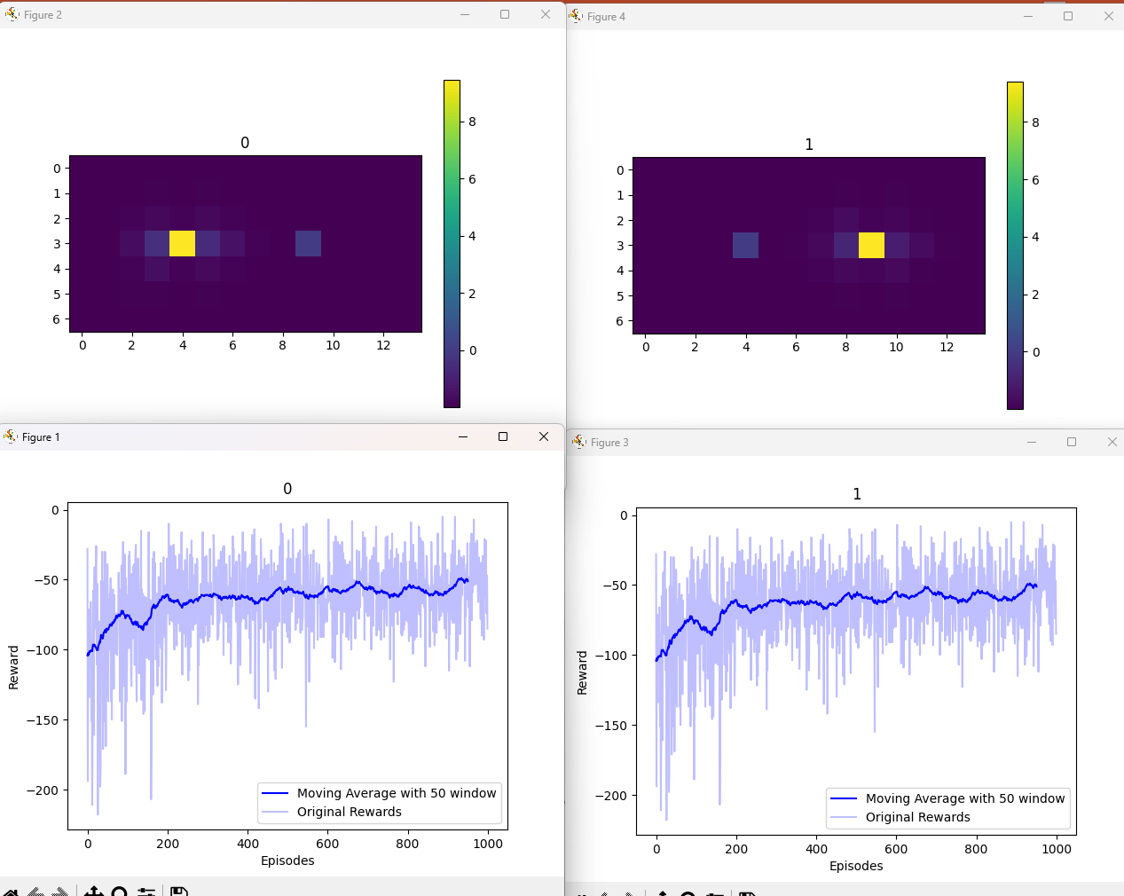
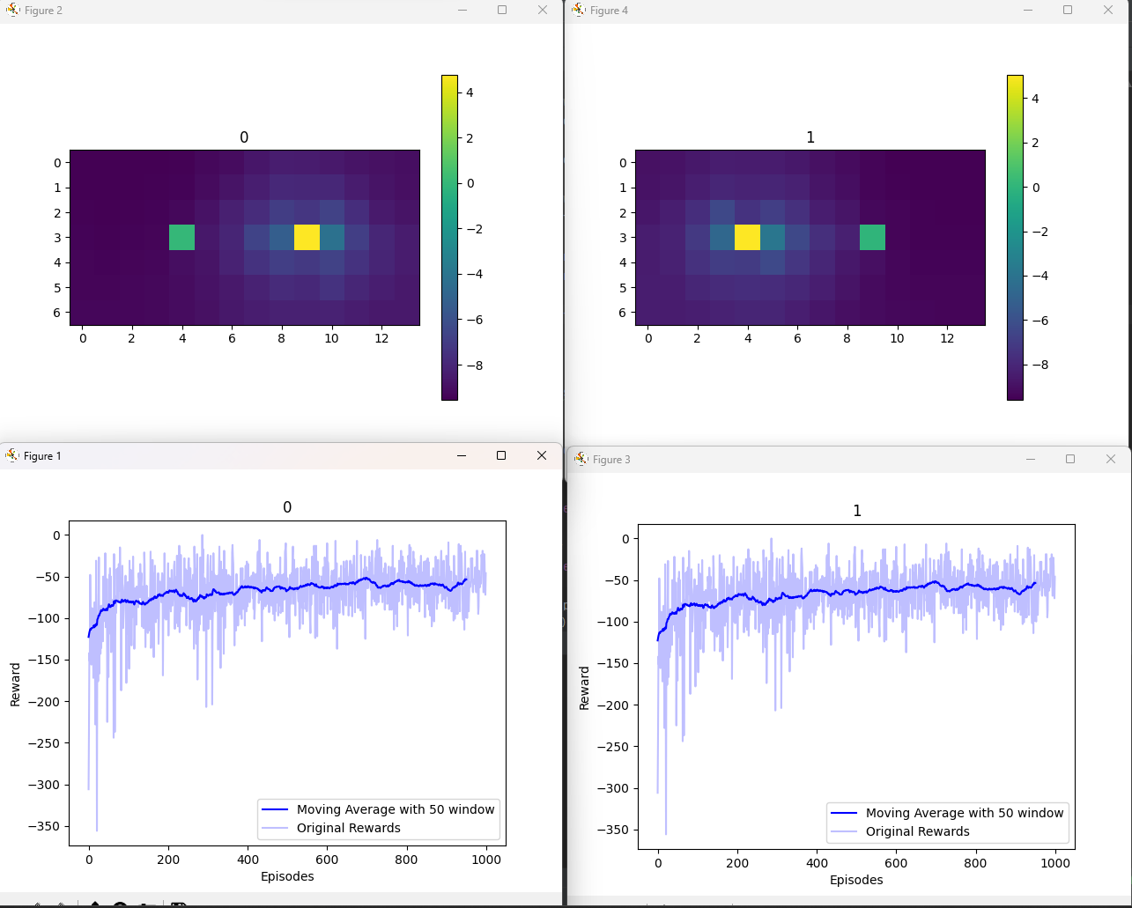
Gamma = 0.5
Epsilon * 0.995
Gamma = 0.9
Epsilon * 0.995

Slide 14
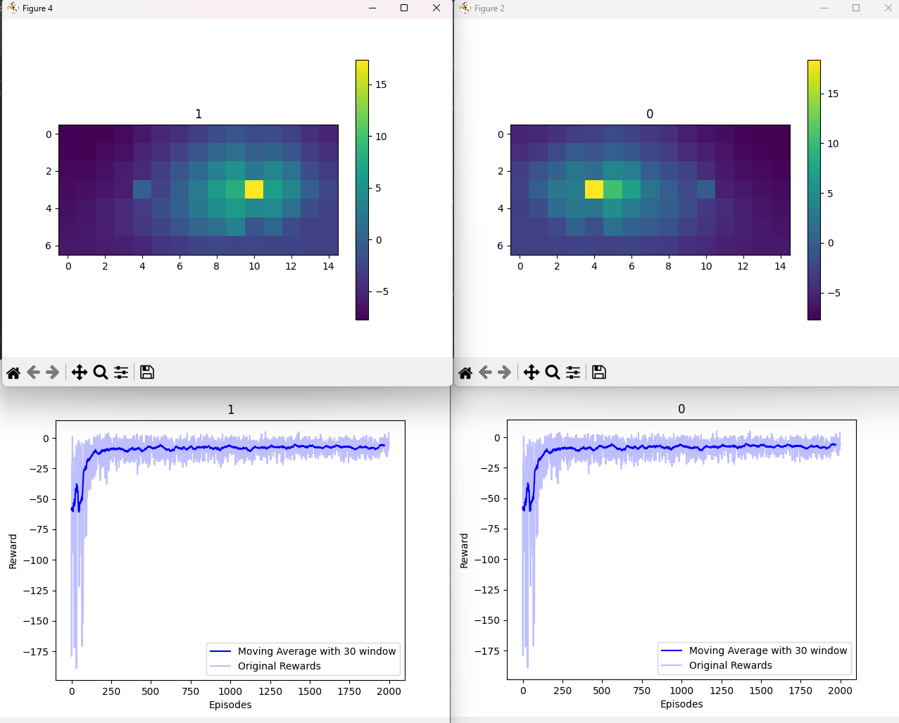
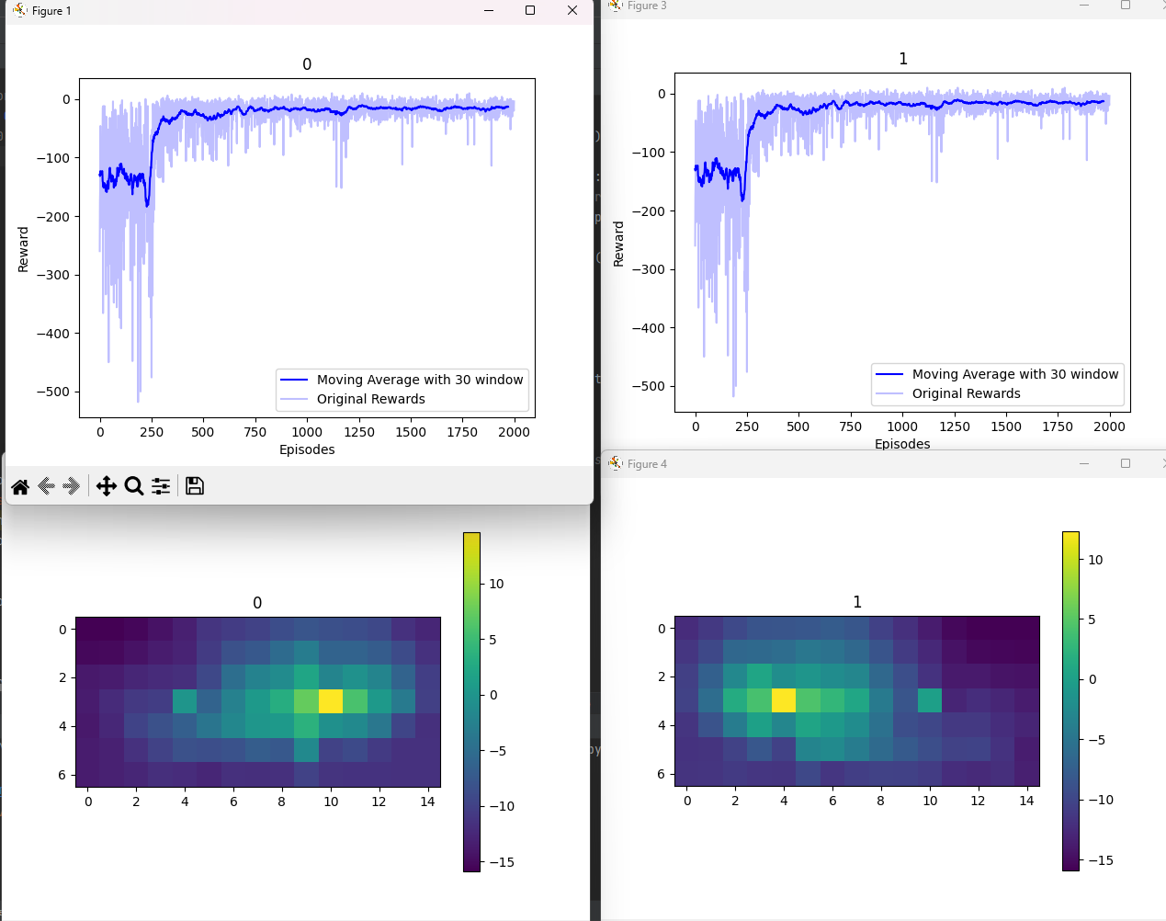
Locla reward
Gamma = 0.9, Epsilon * 0.9

Slide 15
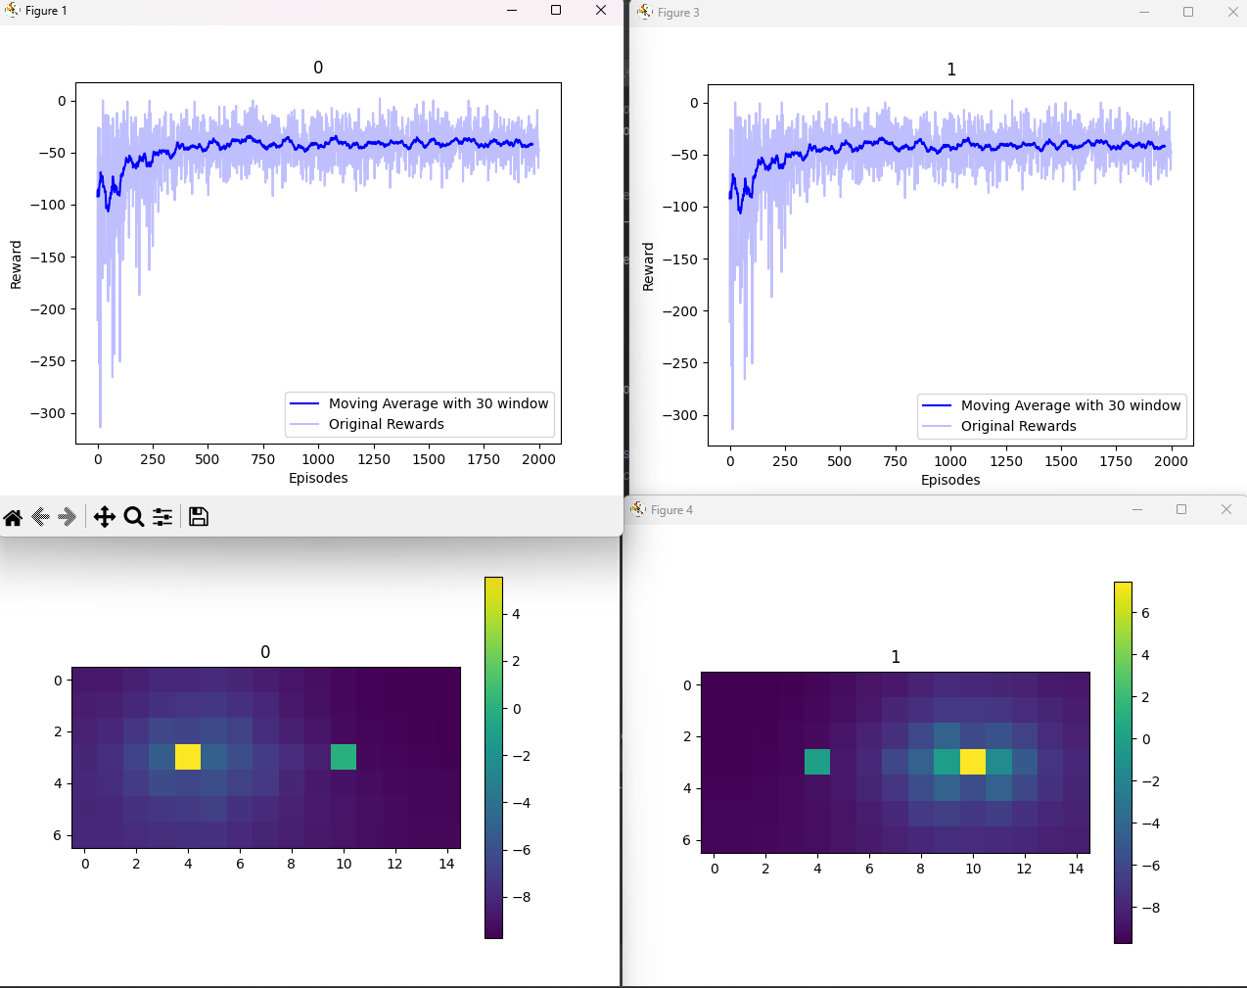
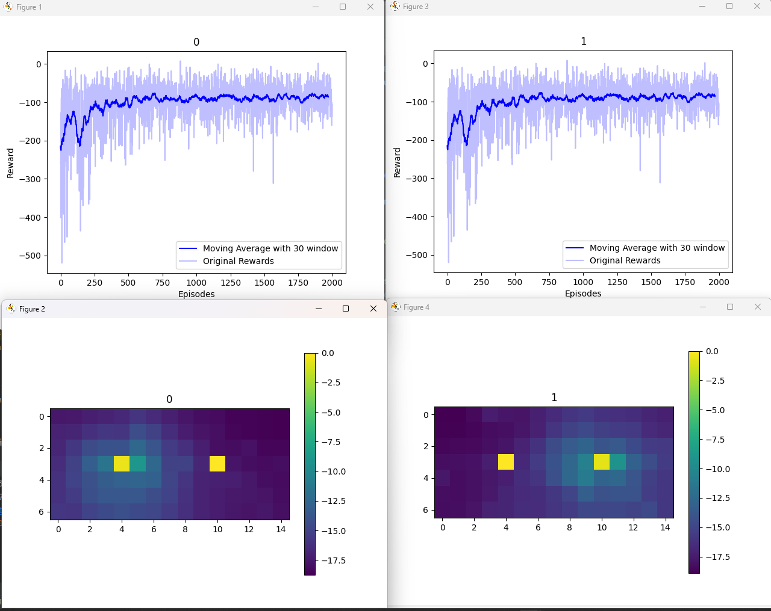
Locla reward
Gamma = 0.9, Epsilon * 0.99
Global
Gamma = 0.9, Epsilon * 0.99

Slide 16
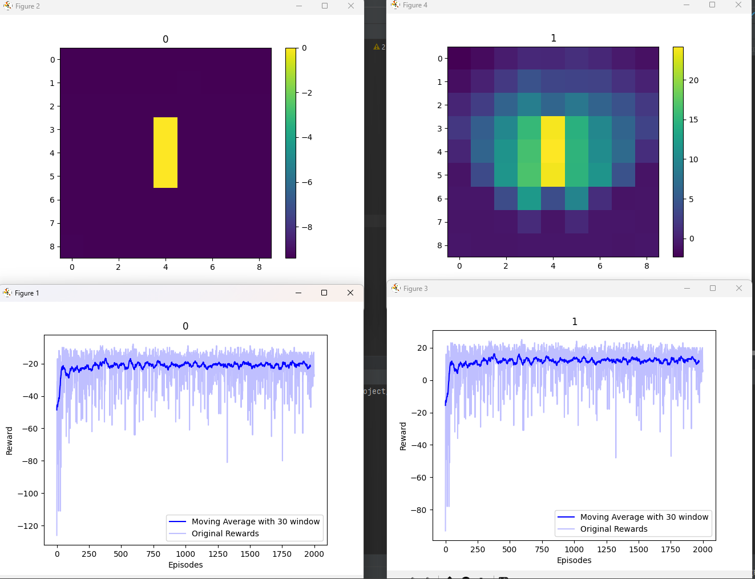
Diff Reward
Gamma = 0.9, Epsilon * 0.9

Slide 17
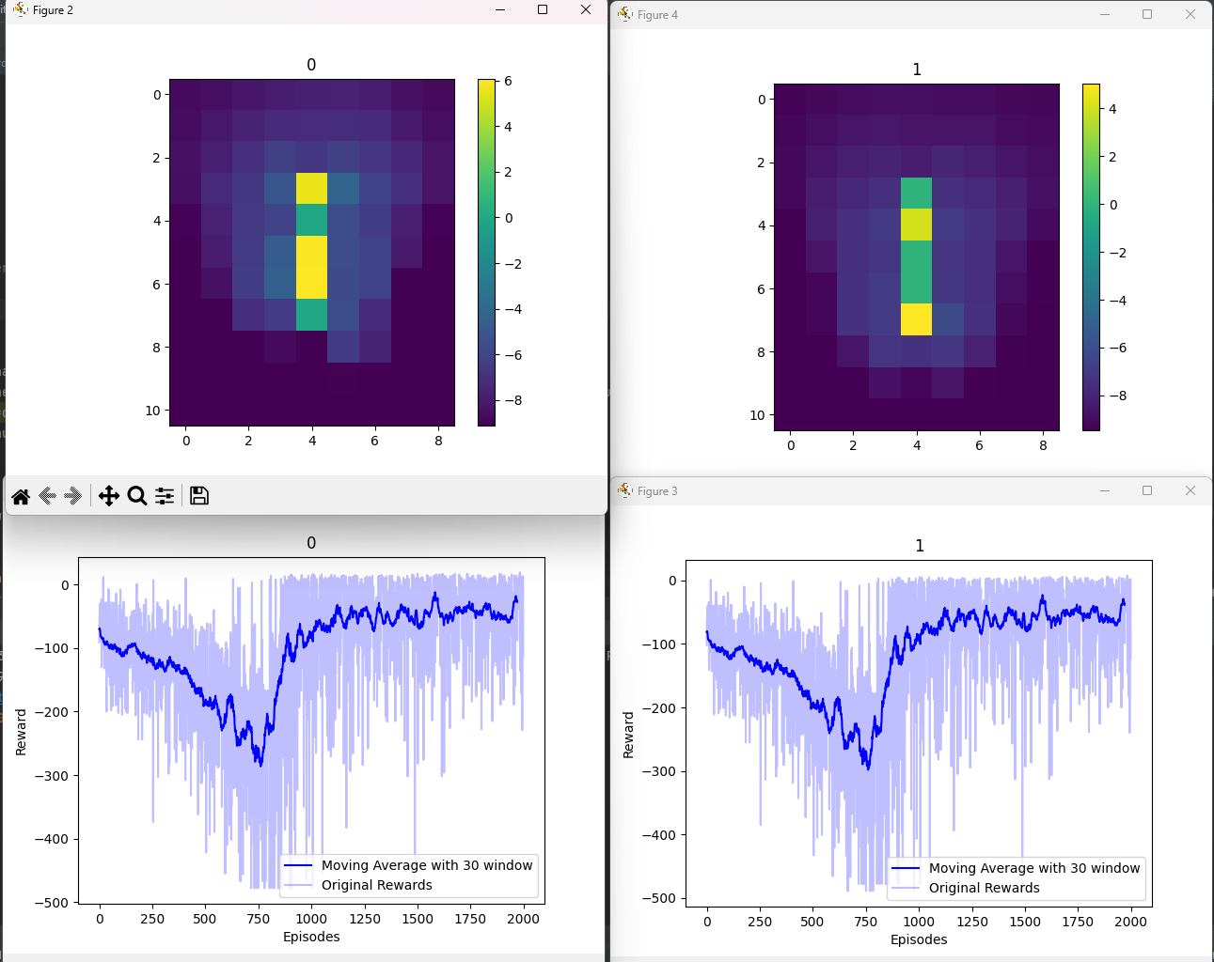
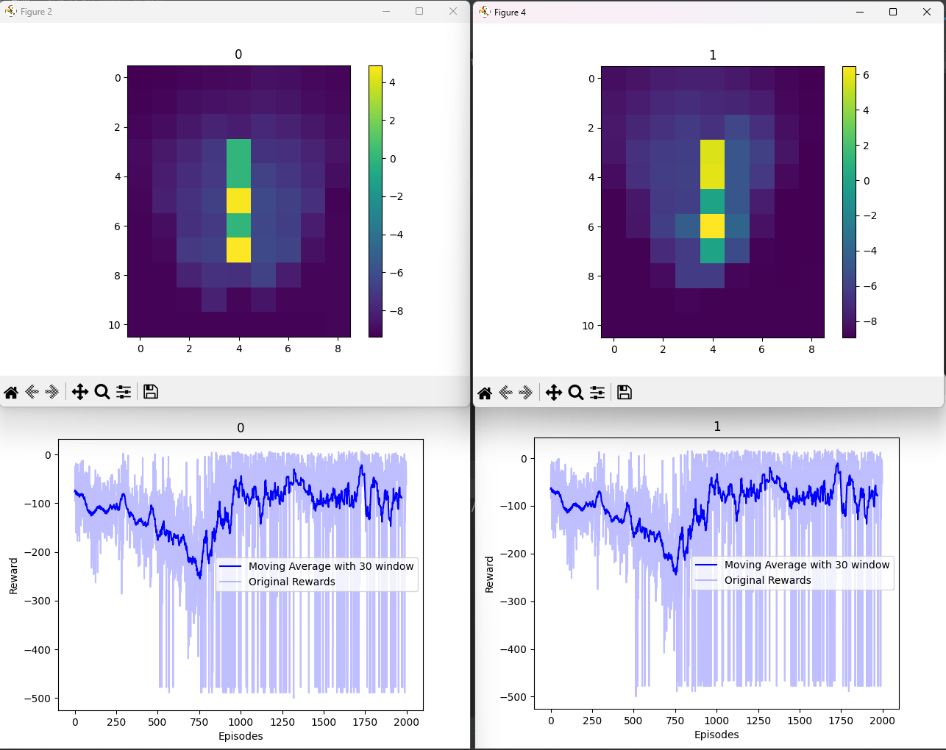
Local Reward
Gamma = 0.9, Epsilon * 0.9
Diff Reward
Gamma = 0.9, Epsilon * 0.9

Slide 19
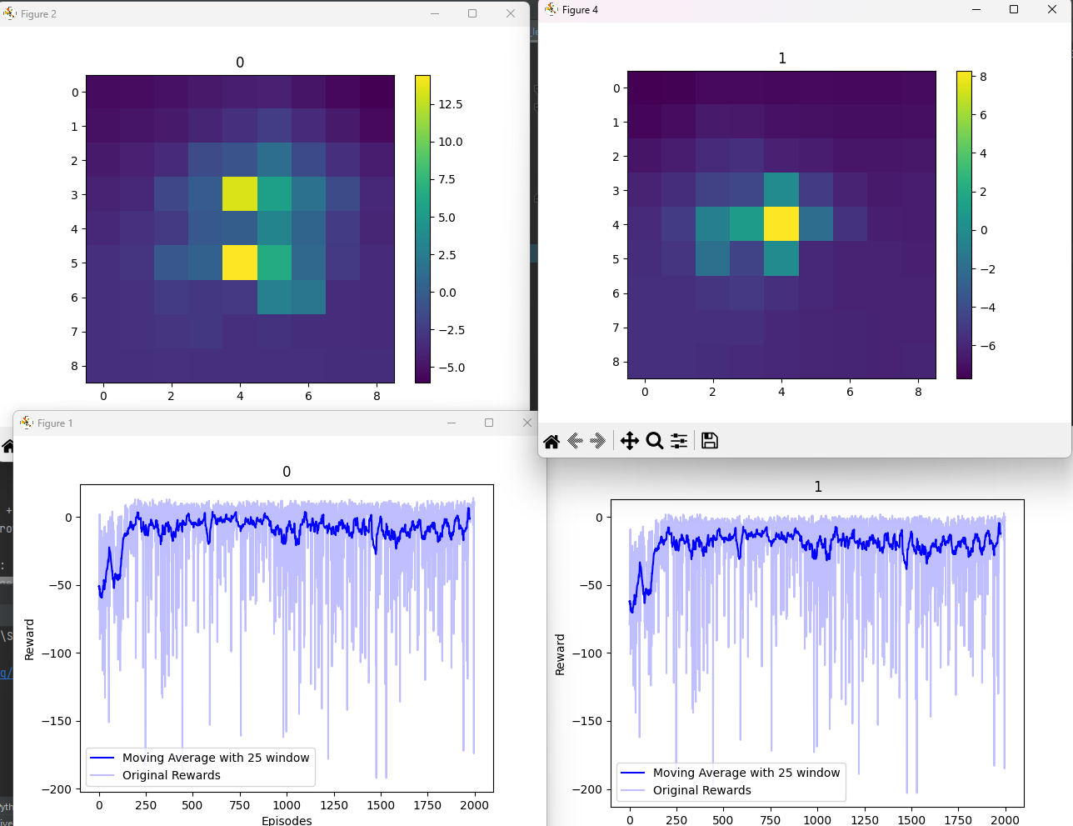

Slide 20
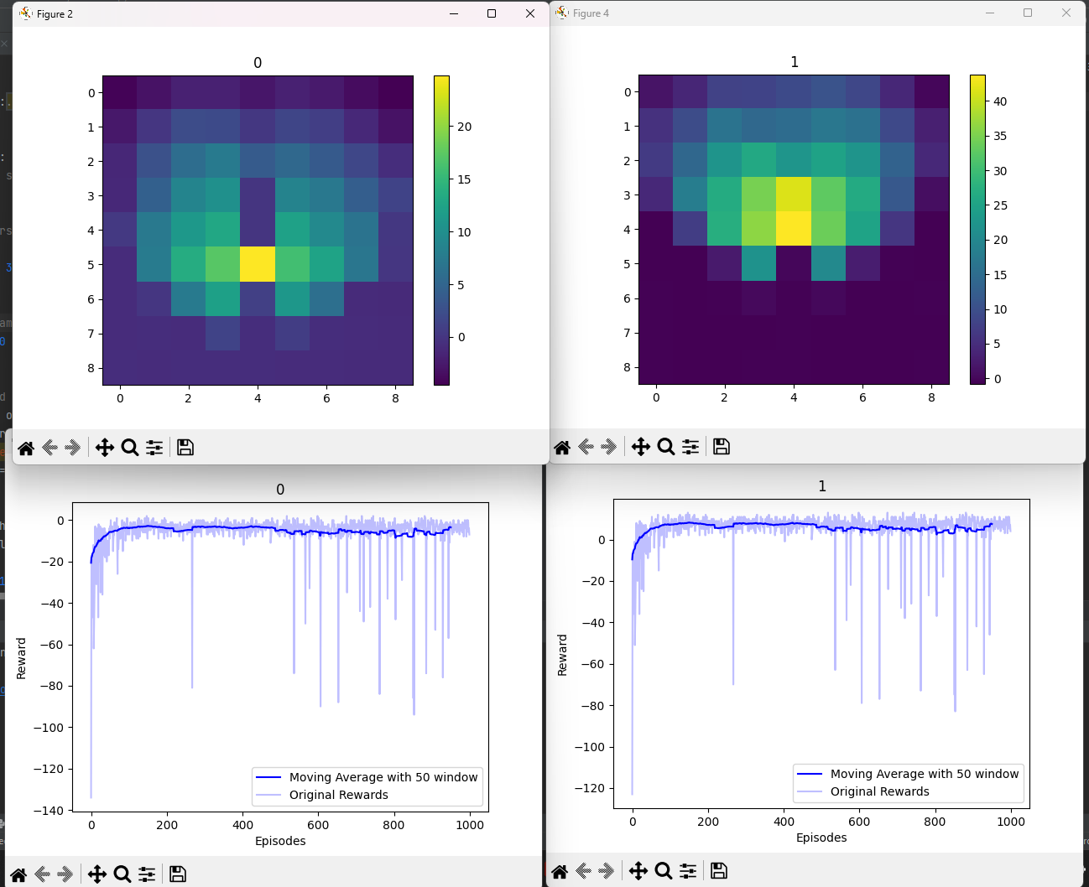

Slide 21
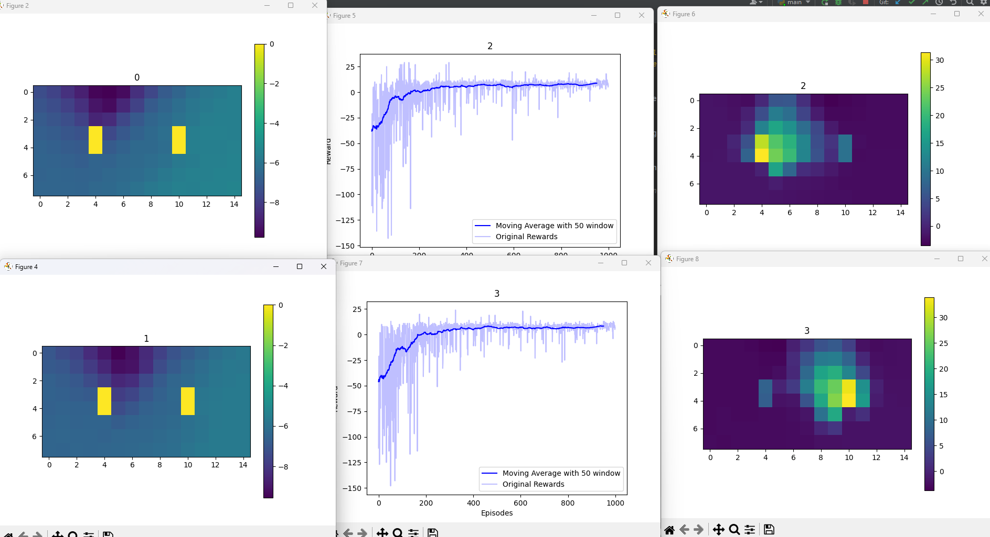

Slide 22
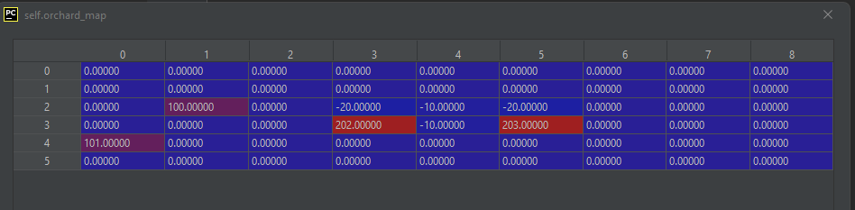
Bug (when there are more than 2 agents same typ)
When two agents are in front of the same tree, who should take it?
The problem here, is that there is no action sequence
Solution 1: add ’10 in the sequence

Slide 24
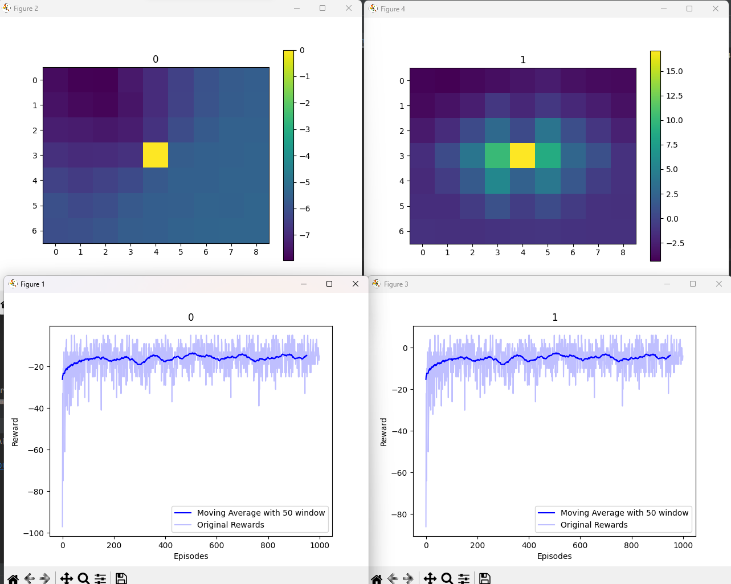
Local

Slide 25
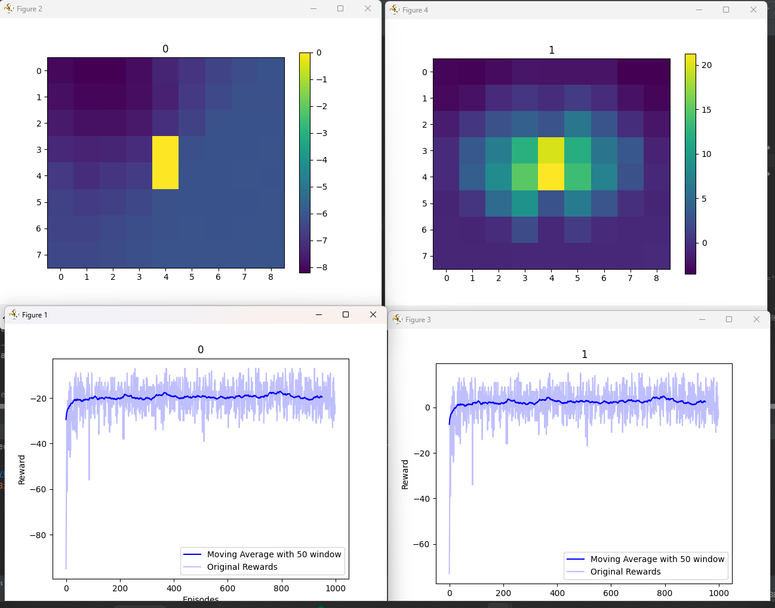
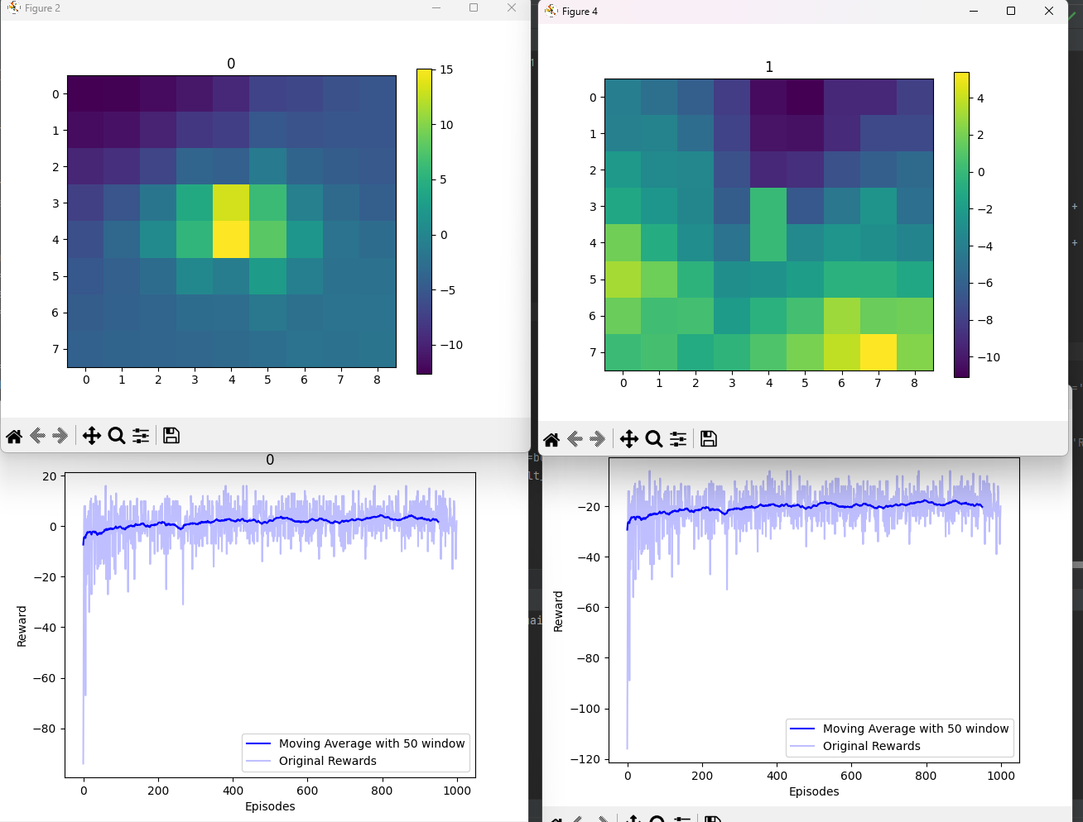
Local
GLobal

Slide 26
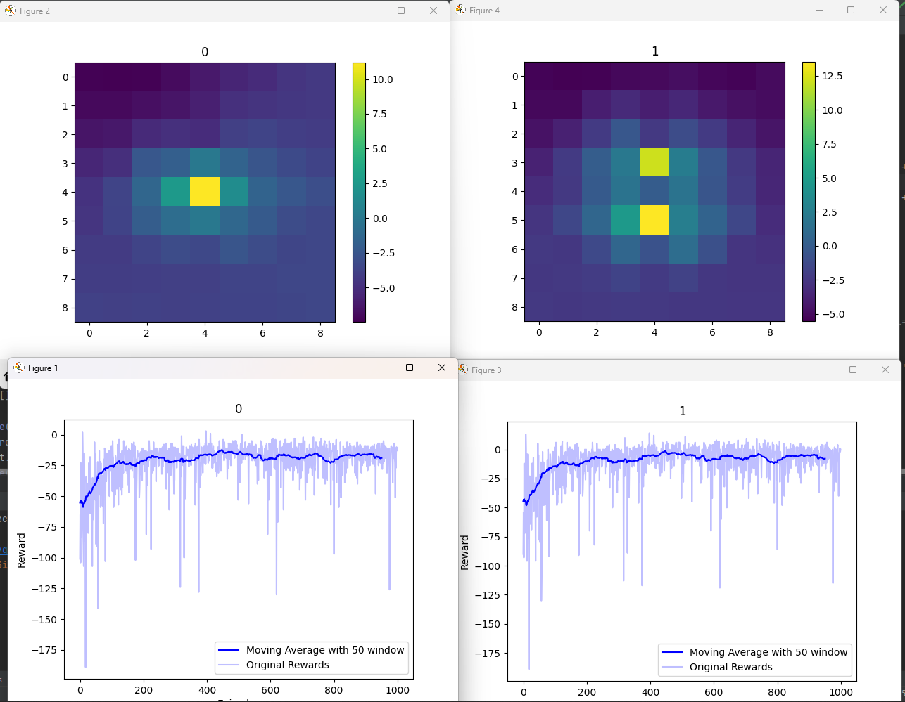
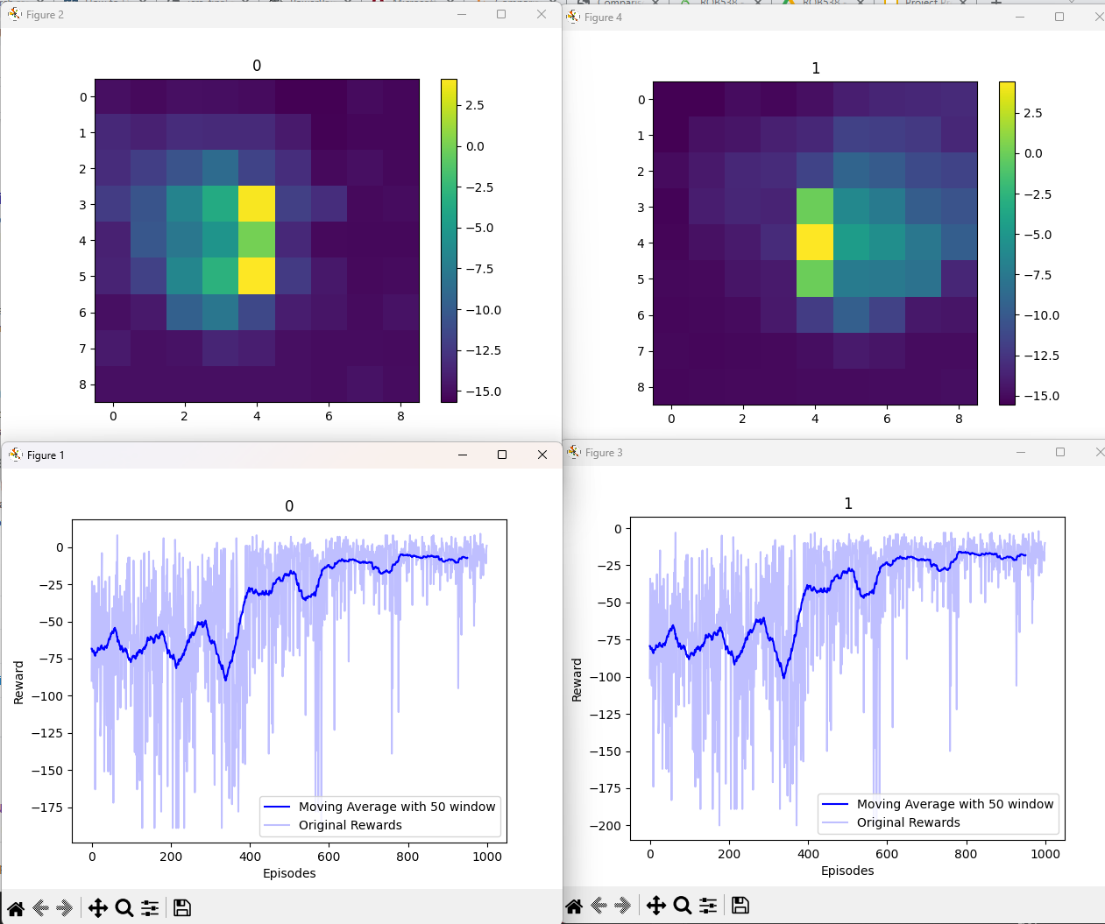
Local
Global

Slide 27
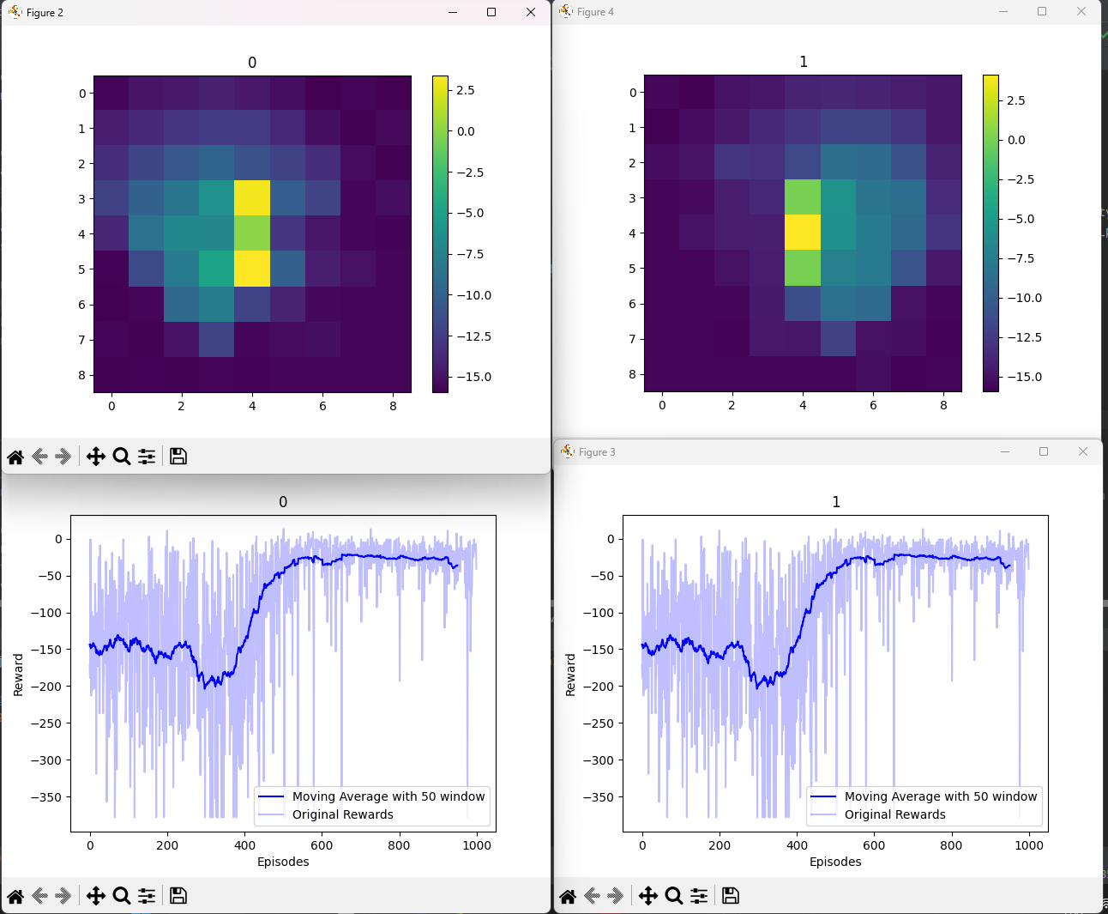
i.accumulated_reward = i.accumulated_reward + global_reward

Slide 28
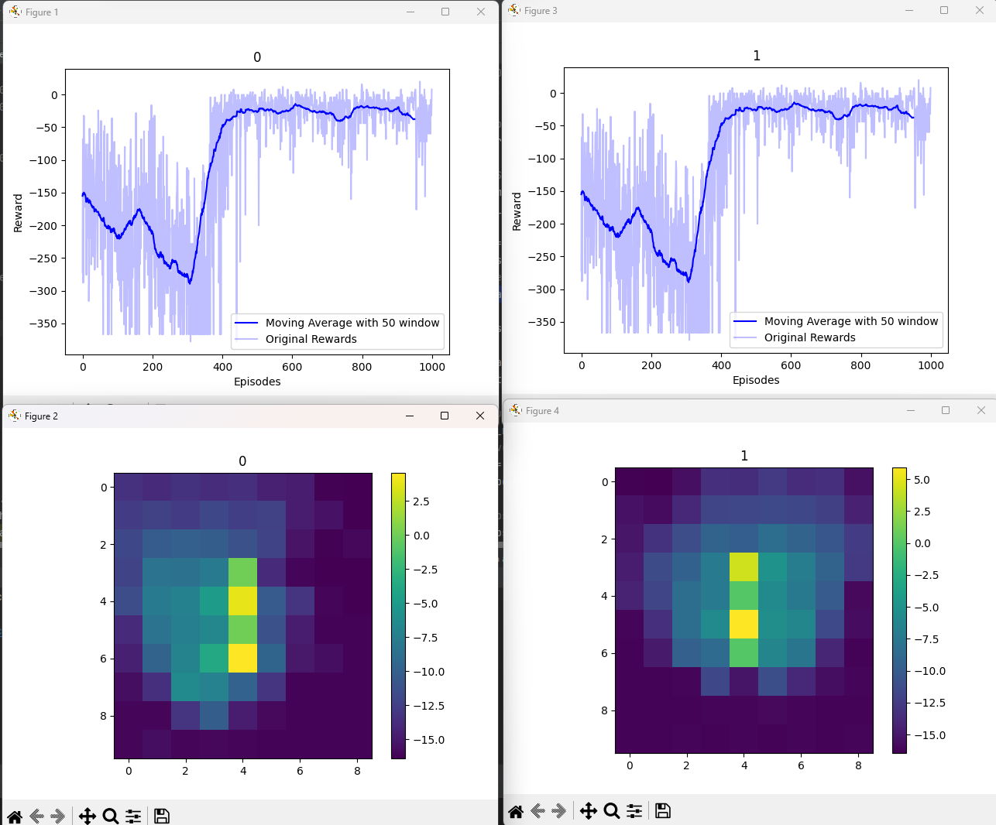
i.accumulated_reward = i.accumulated_reward + global_reward

Slide 29
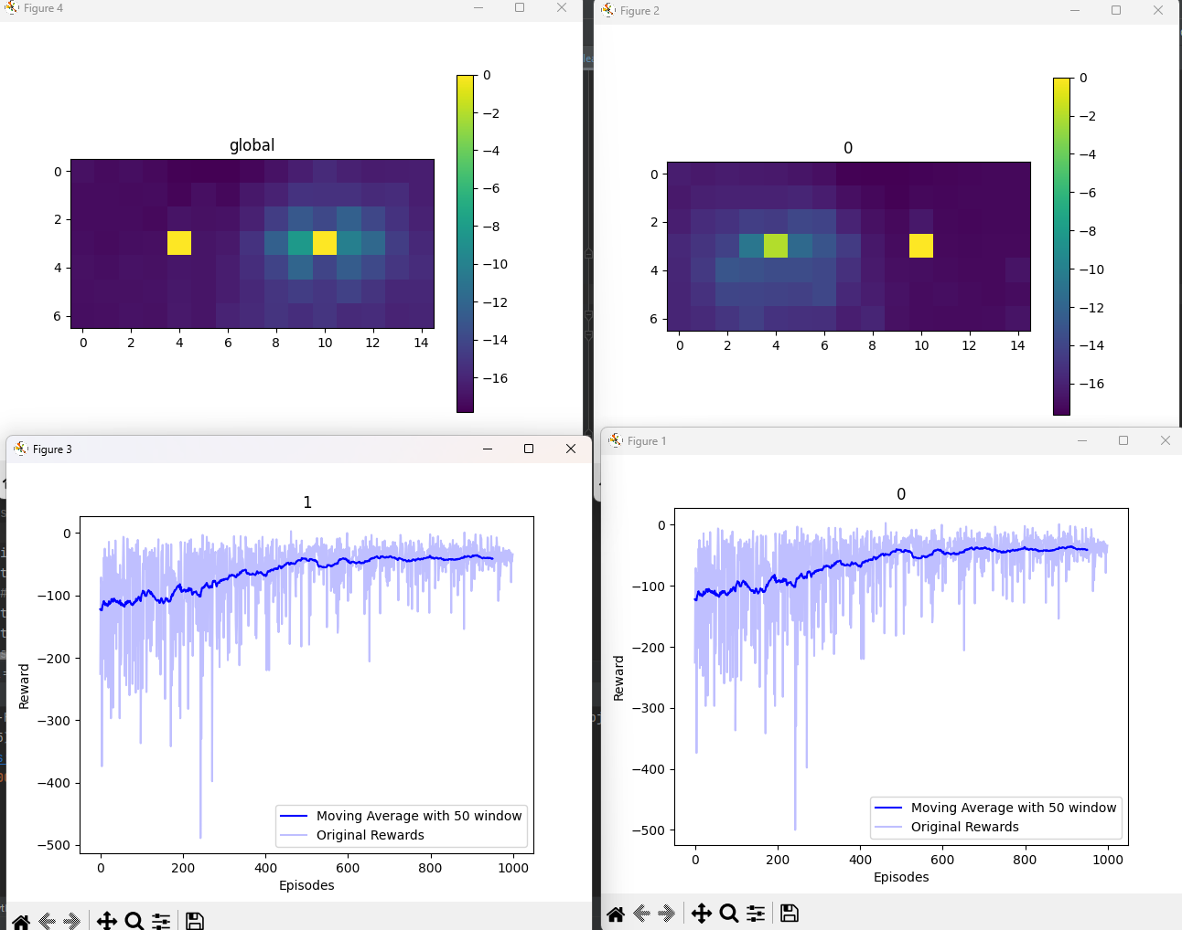
Global
i.accumulated_reward = i.accumulated_reward + i.reward
global

Slide 31
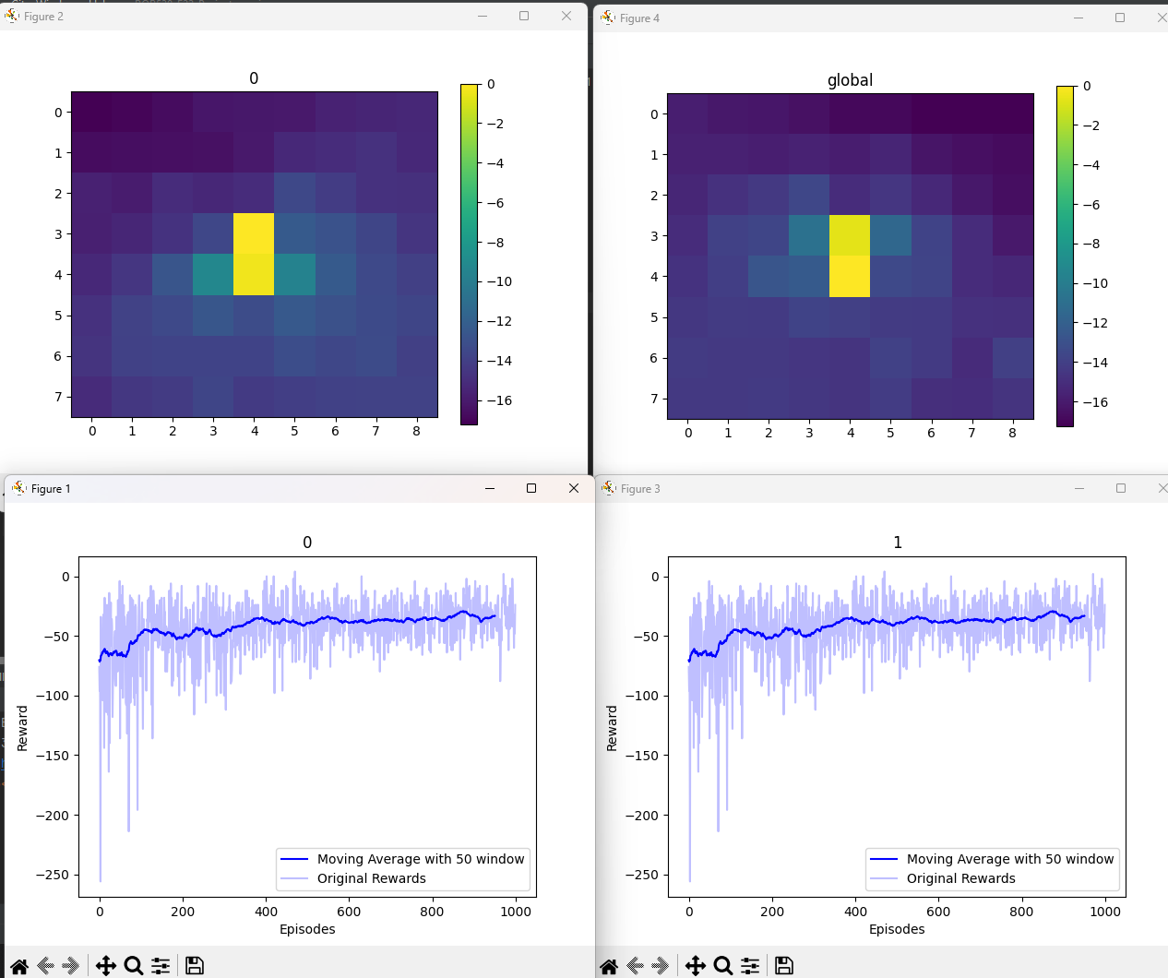
Global
i.accumulated_reward = i.accumulated_reward + i.reward

Slide 32
Trying different globals

Slide 33
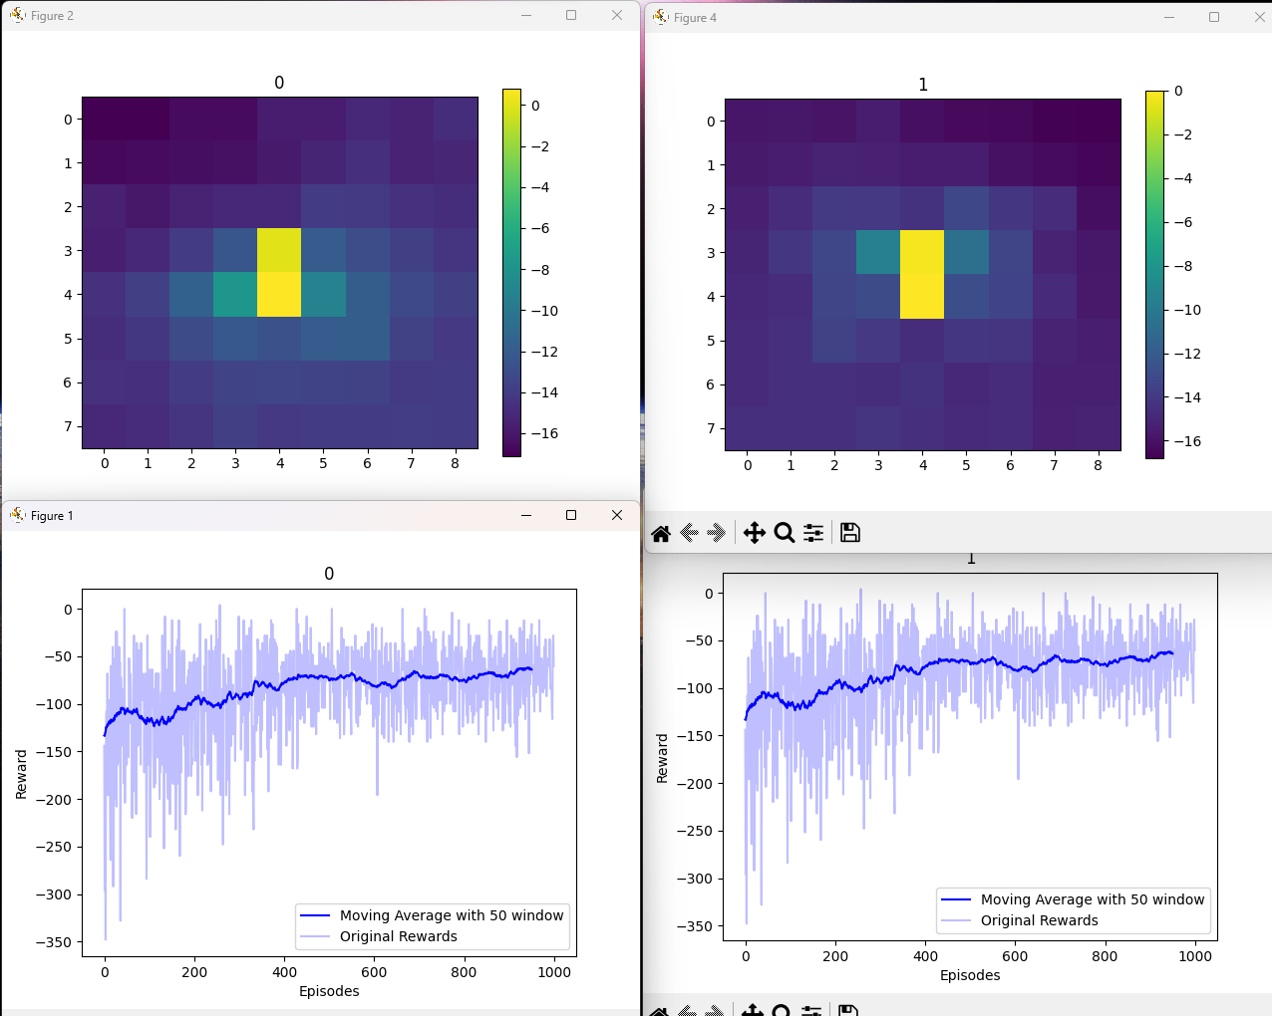
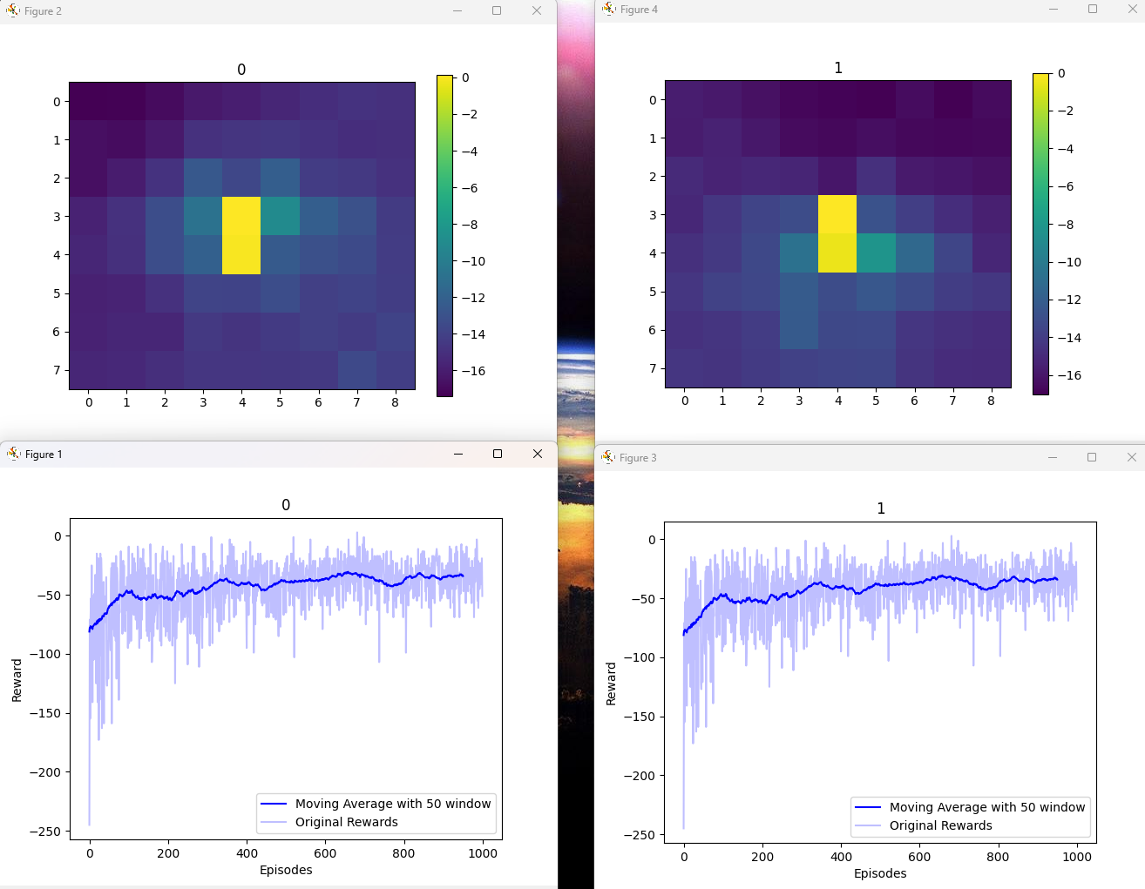
i.accumulated_reward = i.accumulated_reward + global_reward
i.accumulated_reward = i.accumulated_reward + i.reward

Slide 34
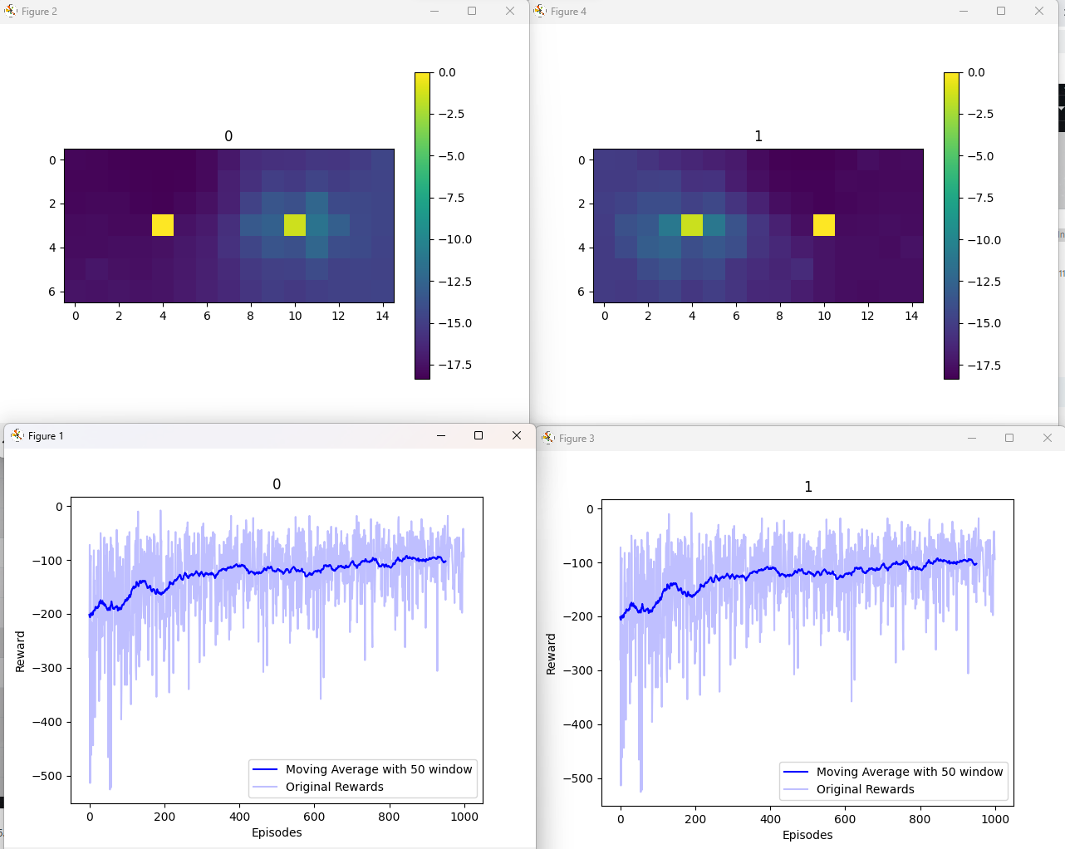
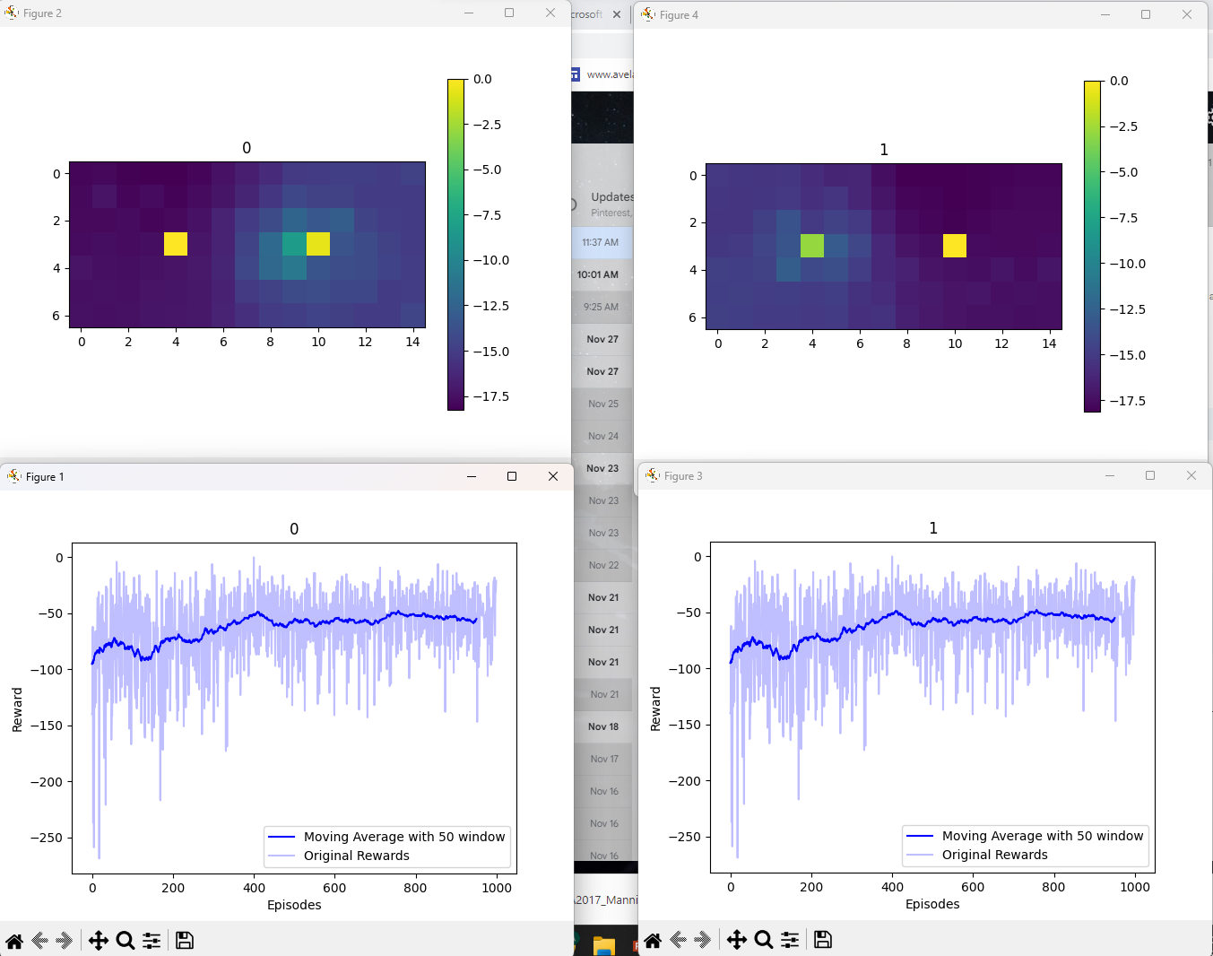
i.accumulated_reward = i.accumulated_reward + global_reward
i.accumulated_reward = i.accumulated_reward + i.reward

Slide 35
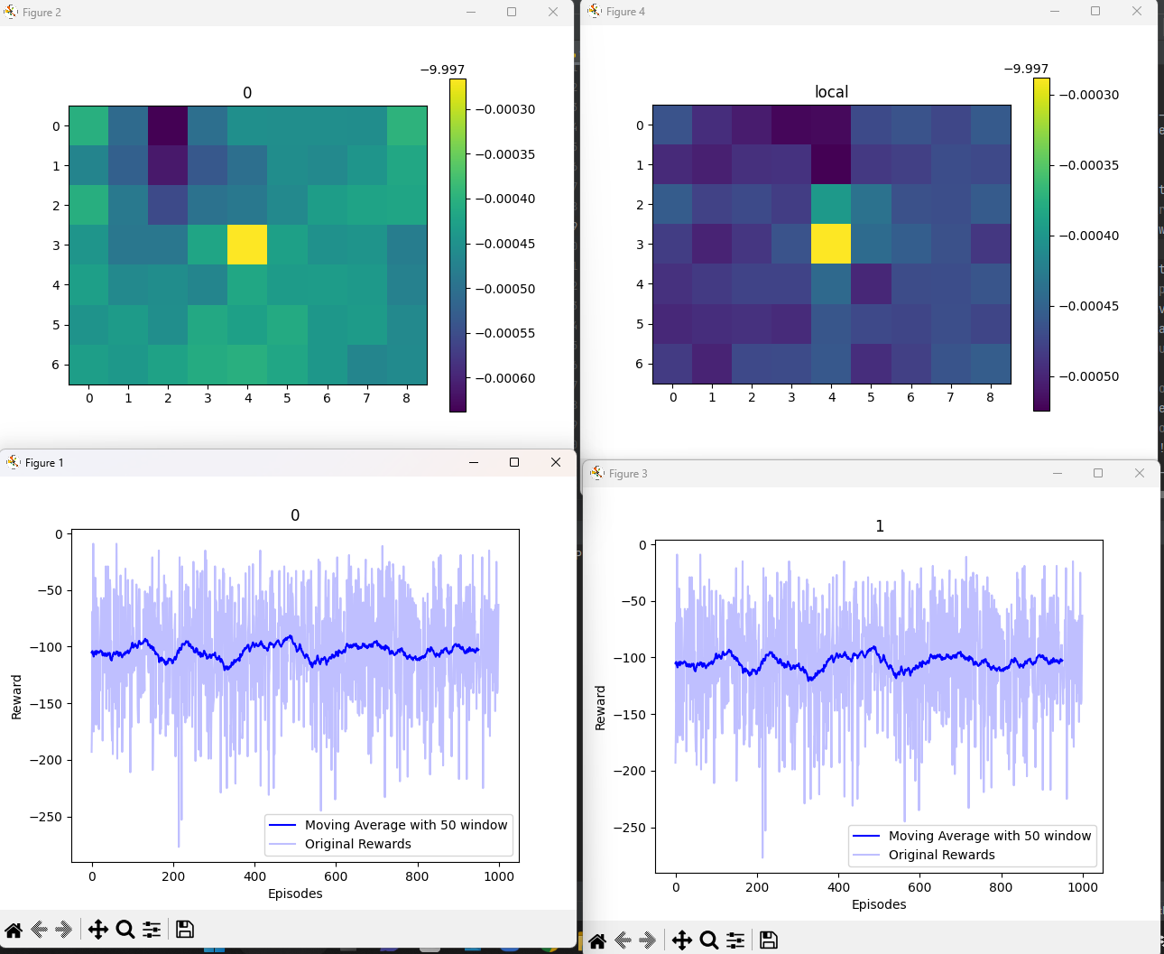
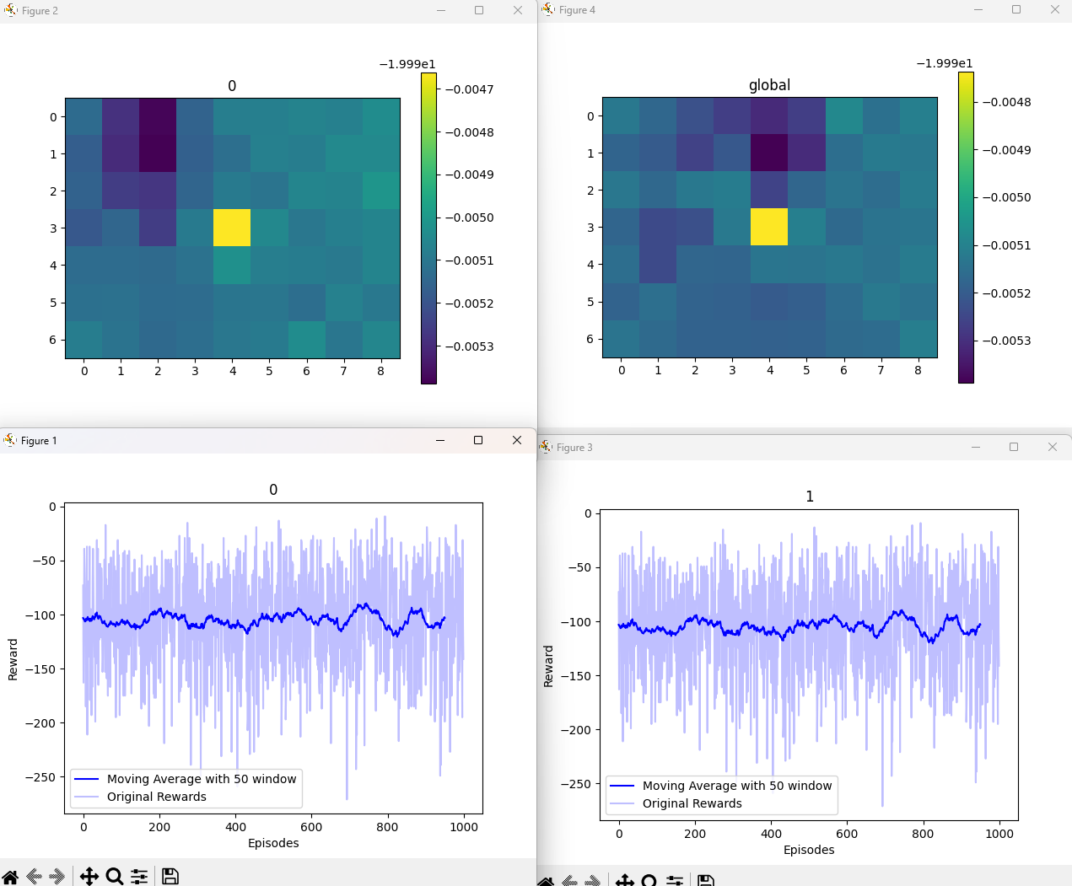
With tightly coupled
Local
global

Slide 36
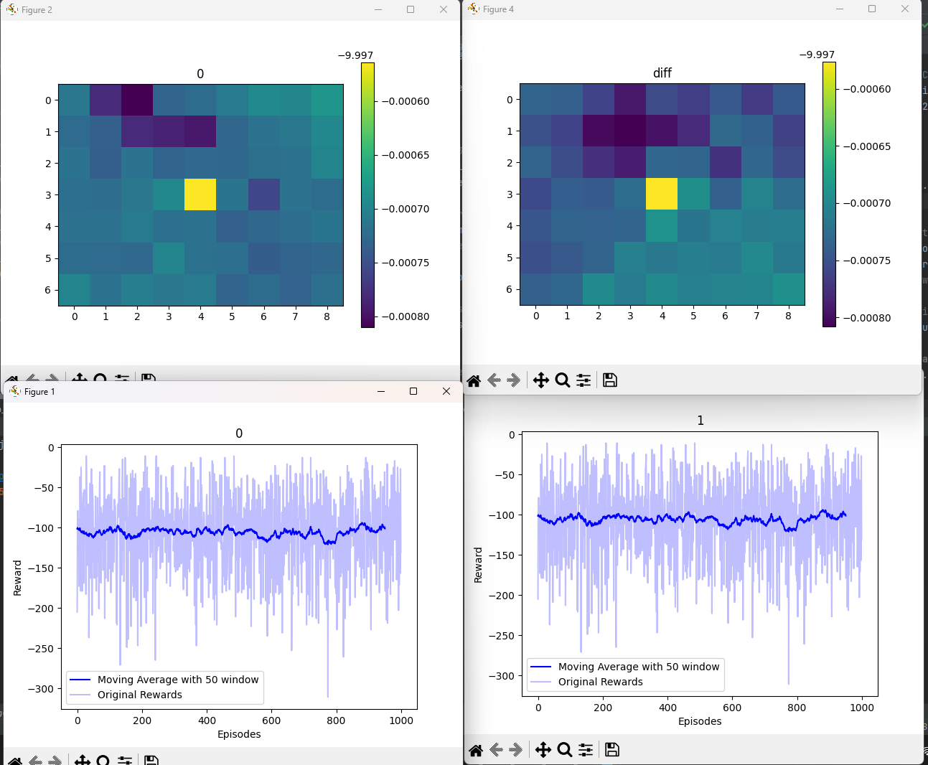
With tightly coupled
diff
D++

Slide 37
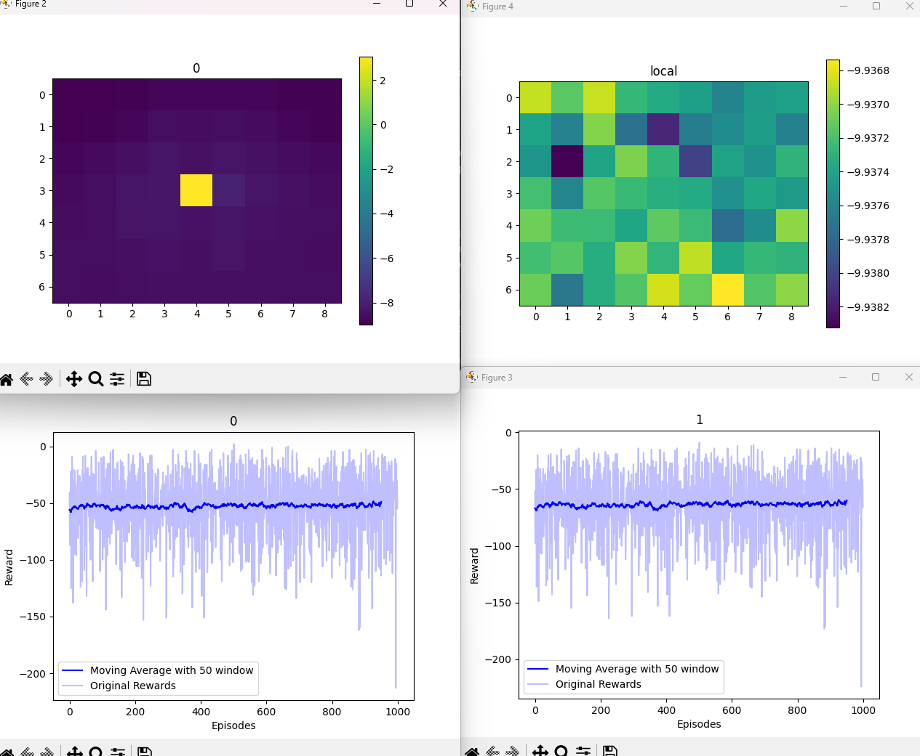
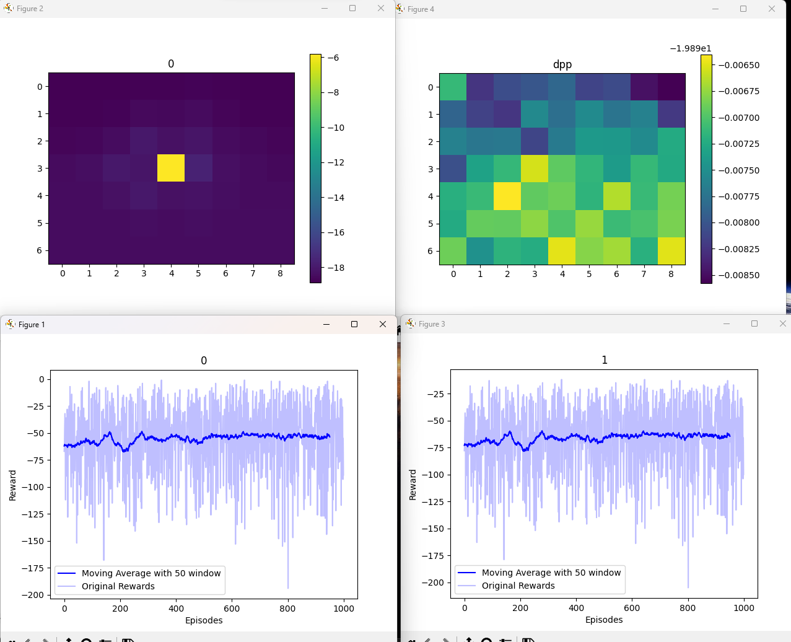

Slide 38
D++
Generate stepping stone with other agents
Encourage agents to pair with other agents
WARNING → Reward Map
To avoid jumping, avoid going back to previous

Slide 39
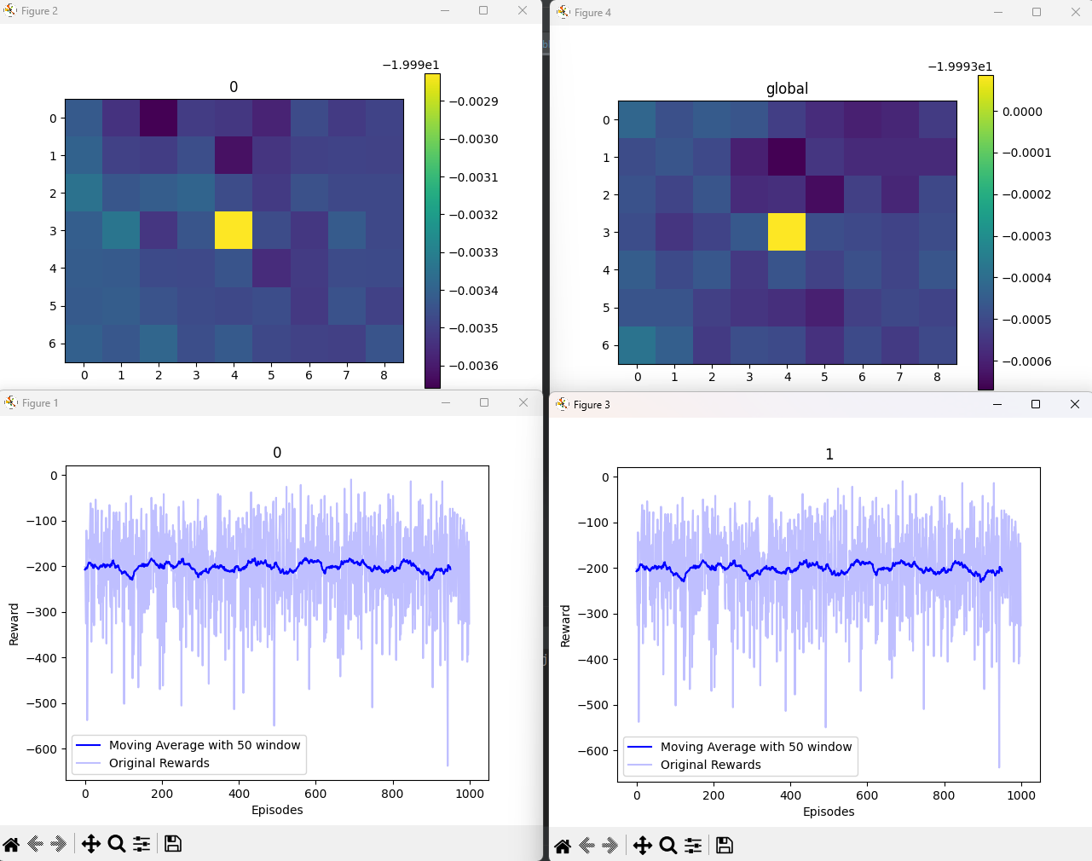
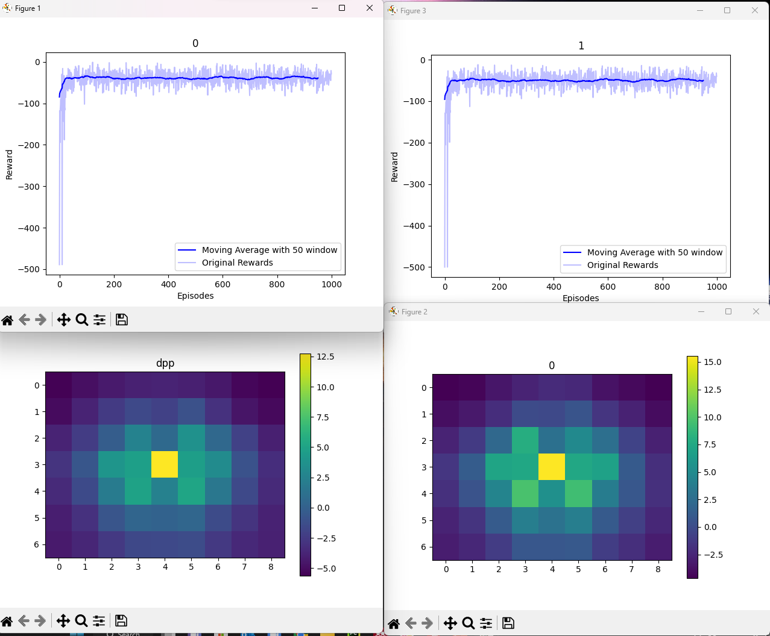
Local
Dpp

Slide 40
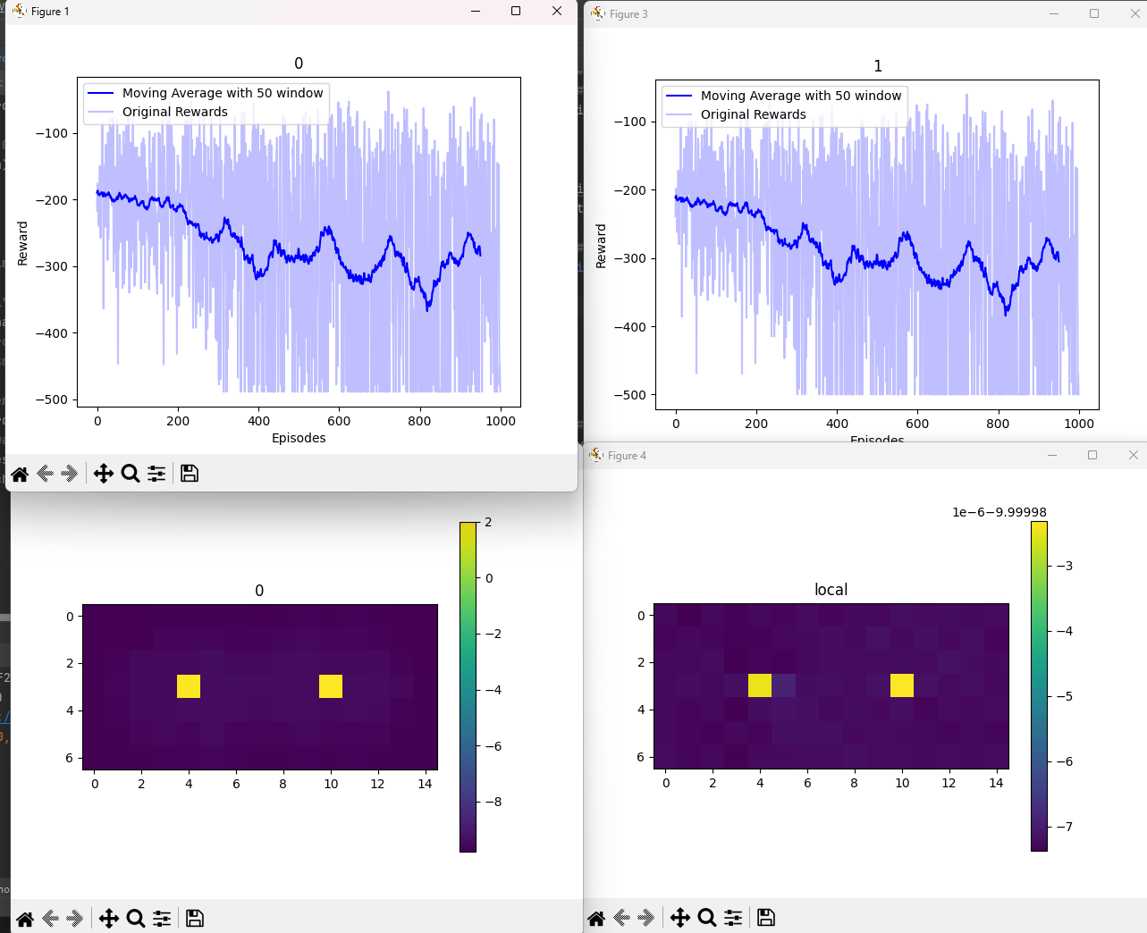
Local

Slide 41
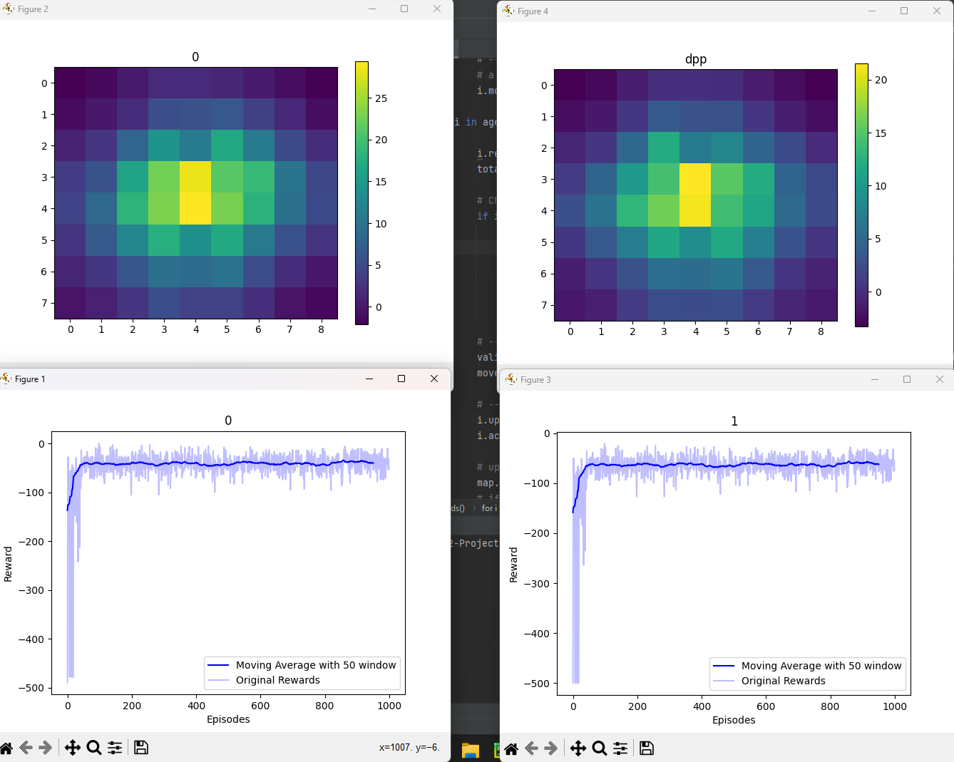
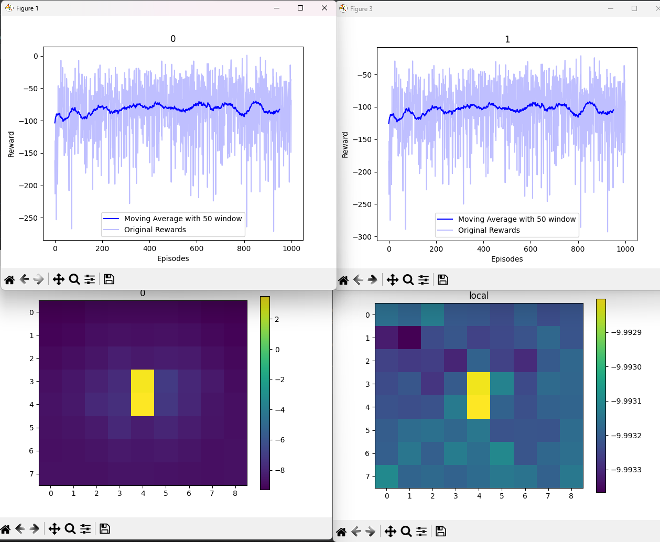
Tree 3
Dpp
Epsilon * 0.99, steps =1000
Local

Slide 42


dpp
local

Slide 43


Slide 44

Tree 3

Slide 45




Same type issue

